Slide 1
www.space-awareness.com - @space_awe
HOW TO MANAGE DIVERSITY AND GENDER BALANCE
IN THE CLASSROOM USING SPACE

Slide 2
Join the survey on kahoot.it
Answer simple questions and discuss the results
Notes:
We all agree that diversity is one thing we all have in common. To start with, we would like to invite participants to share their ideas about diversity in a word cloud.

Slide 3
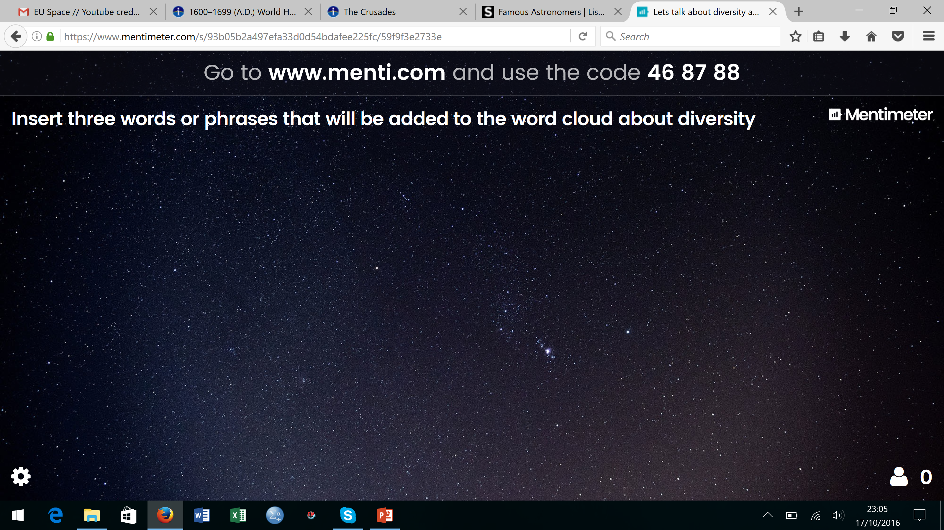
Go to www.menti.com and enter the code 53 84 53
Insert three words or phrases that will be added to the word cloud about diversity.
Notes:
See the cloud of words about diversity. What does it say about people’s perceptions?

Slide 4
Watch the video
What is privilege?
Notes:
Now, please watch the following video, and reflect on your own school context. For example, can you as a teacher apply this into your classroom taking into account the emotional well-being of your students? How should/could you alter such an activity? For what age groups could this activity work with?

Slide 5
Do you think you may do this activity with your students ?
Would you do it the same way?
WHAT IS PRIVILEDGE?
Notes:
See the cloud of words about diversity. What does it say about people’s perceptions?

Slide 6
WHAT DO WE MEAN
BY DIVERSITY AND GENDER BALANCE
IN EDUCATION?

Slide 7
Universal Declaration of Human Rights
Educating shall be directed to the full development of the human personality and to the strengthening of respect for human rights and fundamental freedoms. It shall promote understanding, tolerance and friendship among all nations, racial or religious groups, and shall further the activities of the United Nations for the maintenance of peace.
Article 26 , United Nations, General Conference, San Francisco, 10 December 1948

Slide 8
Inclusive Education is about diversity as the one thing we all have in common.
Unfortunately society has not always dealt well with diversity and has created barriers to learning.
A barrier to learning is defined as anything that stands in the way of a child being able to learn and to participate on an equal basis with their peers.

Slide 9
Participation is the action of taking part in something.
Participation in education links to the ideas of equity and social justice.
If someone is excluded and marginalized from education, then one is not participating.

Slide 10
Education has an important role in shaping individuals’ future life chances.
Historically men held strong advantages In the domain of education, but women have reached parity on most educational markers.
Gender disparities remain in the fields of STEM.
Notes:
Riegle‐Crumb, C., & Moore, C. (2014) studied the gender gap in high school physics and the analyses show that the degree of gender difference varies in relation to the gendered context of the local community labor force.
Gender disparities remain in the fields of STEM (Freeman, 2004; Nord et al., 2011).

Slide 11
We, as educators, must be aware of the “hidden curriculum”* or symbolic curriculum, the school context and culture, the whole community of educators, including parents, professional role models, etc. …
as they all influence the educational process.
* The term was explored by John Dewey in his early 20th century works and since then used by several authors. The phrase "hidden curriculum" was coined by Philip W. Jackson (Life In Classrooms, 1968).
Notes:
We are constantly learning in formal and informal contexts and communicating messages using our behavior, attitudes, opinions: the images in the textbooks, the examples we give to illustrate a subject, etc…
Giroux, H. A., & Penna, A. N. (1979). Social education in the classroom: The dynamics of the hidden curriculum. Theory & Research in Social Education, 7(1), 21-42.

Slide 12
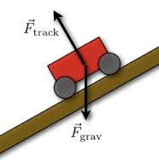
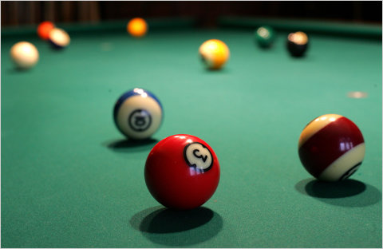
If I always use examples that are more related with the interests of a certain group, gender or culture,
I may loose the interest of other pupils.

Slide 13
Misbehave
reinforcing attitude and pupil´s behavior,
influencing the peers opinion
Or
Create a strategy to engage all pupils?
Fight Stereotypes

Slide 14
Foster participation, make everyone aware that their voice and opinion are important.
We may find barriers related to:
Race, Ethnicity and Culture
Gender
Sexual Orientation
Disabilities
Etc.

Slide 15
GENERAL GUIDELINES*
Actively Challenge Stereotypes
Actively target girls, but design for boys and girls
Address women and minorities invisibility in science: highlight women scientists
Promote “mentors” and provide “role models”
Target parents
Adopt participatory design approaches
Mirror your own profile and of your own institution
*These guidelines were adapted from the following projects: TWIST; @mindset; Hypatia
Notes:
Guidelines to manage diversity and gender balance in the classroom through Space*
Actively Challenge Stereotypes
Give practical examples when someone in the classroom is highlighting a stereotype. For instance, if someone says space is for boys, you may show different examples of women working on space related careers. You may use the role model videos that space awareness project prepared, showing on a concrete way that space jobs are for both girls and boys.
Actively target girls, but design for boys and girls
Female friendly approaches give girls the choice of opting out or performing gender in the specific way that is sanctioned by science culture. This serves to maintain, rather than erase, stereotypical gender identities. Every child is different. Variations in the way children learn are found not only between genders, but also within every person, so differences in science engagement among learners of the same sex are at least as important as the differences between the two sexes. So, encourage all learners to value their own experiences and interests, and reflect on their relevance for science learning. This practice may help establish an increased awareness of all marginalised groups of learners, irrespective of sex (Allegrini, 2015; Sinnes & Løken, 2014).
Address women invisibility in science: highlight women scientists
Give examples of the diverse contributions of many different cultures to space science and the contributions made by both women and men, highlighting the women scientists, which traditionally have been invisible on scientific fields. Once again, you may use videos and interviews from Women working in Space Scientific Careers.
Promote “mentors” and provide “role models”
The idea that space is just for excellent students and that space topics are too specific and not related to social aspects have to be demystified; role models are to be used, visiting and interacting with scientists of different cultural and socioeconomically backgrounds.
Target parents
Parents have an important influence on future choices of academic and professional areas of their children. Make sure that parents are aware of science careers choices to their children, inclusive on space sciences field.
Adopt participatory design approaches
Use examples that are related with interests of different groups, gender or culture. Enhance your teaching practices by adopting participatory approaches, like Inquiry Based Science Education, the use of ICT tools, etc.
Mirror your own gender and cultural equity and of your own institution
To create education activities that are inclusive for a wide diversity of learners, it is crucial we question ourselves as educators, our institutions as places of learning, and our national cultures as the contexts within which our teaching is embodied. Question yourself if, implicitly or explicitly, implying certain types of learners.

Slide 16
WHAT YOU CAN DO
Create inclusive activities adapted to a gender and culturally diverse classroom
Make sure that the activity can be completed by all students
Consider at which point of an activity the teacher might need to confront potential issues of discrimination and manage it.
Teachers should be prepared to confront situations where students might raise controversial issues.
Teachers should challenge their own racial and cultural biases.

Slide 17
WHY USE SPACE TO MANAGE GENDER BALANCE
AND DIVERSITY IN EDUCATION?

Slide 18
WHY SHOULD WE USE SPACE TOPICS?
Astronomy is inspirational for both boys and girls
Is related to our everyday lives
Offers a unique combination of sciences, techniques, and cultures
Fosters Global Citizenship

Slide 19
1. SPACE: THE FAVORITE TOPIC FOR BOTH BOYS AND GIRLS!
Notes:
ROSE, The Relevance of Science Education report (2010) has highlighted that astronomy and space is a very attractive subject for both girls and boys and very effective on the engagement of these students on science subjects. ROSE highlighted that more developed countries have less overall interest in science
Girls and boys interest are context-dependent . Girls, more than boys, are orientated towards values, more people-oriented and care for the environment.
Humanize school science
Show that science is part of human history and culture
Learners should see that S&T are the basis of our current way of life and also the basis of many jobs and occupations

Slide 20
2. SPACE IS RELATED TO OUR EVERYDAY LIFE
Few examples
Transport and mobility: navigation, localisation, urban design…
Health and safety: emergency situations, technology transfer…
Agriculture and food: virtual fencing, drought monitoring. guidance systems
Earth monitoring: weather, climate, pollution (atmosphere, light…), natural disasters, oceans…
Energy: maintenance of installations (offshore, windparks), wind monitoring, technology transfer…
Rosenberg, M., Russo, P., Bladon, G., & Christensen, L. L. (2014)
Notes:
Interesting link about astronomy applications in everyday life: https://www.iau.org/public/themes/astronomy_in_everyday_life/
Current space missions are very much oriented towards the Earth and our lives: examples of the Copernicus, Galileo mission.
https://www.gsa.europa.eu/
http://www.copernicus.eu/

Slide 21
2. SPACE OFFERS A COMBINATION OF SCIENCES, TECHNIQUES, AND CULTURES
SPACE
ELECTRONICS
Most sensitive detectors Fastest clocks
PHYSICS
Laboratory of extremes Making heavy elements
CHEMISTRY
Producing organic molecules
BIOLOGY
Building blocks of life
ANTHRO-POLOGY Ancient civilizations
Our roots
INSPIRATION
Career in science and technology
HISTORY
Evolution of Universe
Our roots
OPTICS High-precision adaptive optics
COMPUTERS Fastest hardware Complex software
SPACE Satellites Miniaturization Precision
PERSPECTIVE IMMENSITY OF UNIVERSE
Tolerance and global citizenship
MATHEM-ATICS Abstract thought
TECHNOLOGY
AND SKILLS
CULTURE
AND SOCIETY
SCIENCE AND
RESEARCH

Slide 22
2. SPACE OFFERS A COMBINATION OF SCIENCES, TECHNIQUES, AND CULTURES
As such, space has to do with STEM subjects, but also:
History: space has been observed and studied from early ages
Language: space sciences need international cooperation
Philosophy: the enormity of the Universe and our place
Art: space is a source of inspiration and raise imagination
Geography: through navigation for example
Etc…

Slide 23
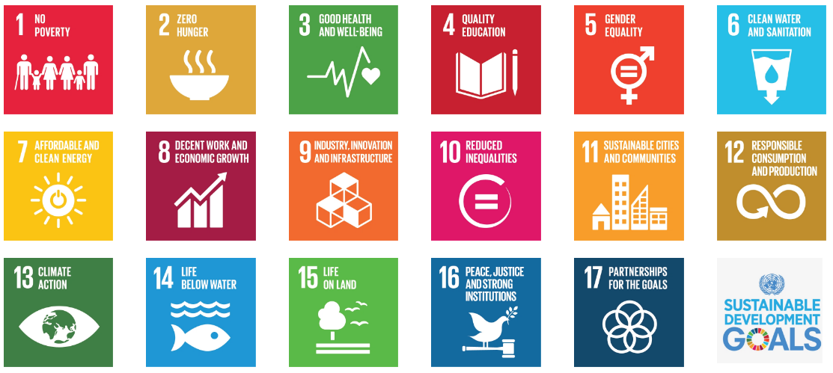
4. SPACE IS A UNIQUE TOOL TO FOSTERS GLOBAL CITIZENSHIP
Space sciences address several UN Sustainable Development Goals
Notes:
See link: http://www.un.org/sustainabledevelopment/sustainable-development-goals/

Slide 24

4. SPACE IS A UNIQUE TOOL TO FOSTERS GLOBAL CITIZENSHIP
From space, the Earth has no frontiers
The Universe is enormous and we are not at the centre
We all share the same fragile and small planet

Slide 25

4. SPACE IS A UNIQUE TOOL TO FOSTERS GLOBAL CITIZENSHIP
"Fanatic ethnic, religious or national identifications are difficult to support when we see our planet as a fragile, blue crescent fading to become an inconspicuous point of light against the bastion and citadel of the stars. “
CARL SAGAN
Notes:
THE EARTH FROM SATURN (CASSINI)

Slide 26
THE IMPORTANCE OF ROLE MODELS

Slide 27
Europe’s knowledge economy developing and new technologies on the rise, skills in science, technology, engineering and mathematics (STEM) will be needed.
Careers are available.
Girls and ethnic minorities are underrepresented.

Slide 28
“Specific attention should be given to raising the participation of girls in key school science subjects and to increasing their self-confidence in science” - Rocard Report (2007 - Recommendation 3)
This is also true for minorities.

Slide 29
Video: Inspiring The Future - Redraw The Balance

