Slide 1
Educational program : Cern through the art of music and theatre Subject : Big Bang
Primary School of Distomo
Sixth Grade
2015-206
Parnou Maria :Special Educator

Slide 2
Indrudaction
In duration of the school year 2015-2016 the sixth grade of secondary school of Distomo ran a program titled: “Cern through the art of music and theatre”
Our main purpose was the students to learn by playing.

Slide 3
teaching method
Our teaching based on:
Co-operative learning
Learning by acting and doing as focus

Slide 4
The beginning and the choice
Everything started when a colleague proposed us to take part to a program in which we would cooperate with other schools of Greece such as the islands of Zakynthos, Milos, Chios and Thymaina.
The subject referred to physics, so for that reason we chose the sixth grade because they study physics in their curriculum and we wanted to make them to be more interested in that lesson.

Slide 5
Program’s intention Was that
•Our students would learn about molecules and atoms.
•Also they would familiarize better with physics.
•They would improve their skills of collaboration and helping each other.
•They would hone their imagination and their creativity.
•And finally they would meet new students from other schools of Greece.

Slide 6
Procedure- Activities
First of all we had a brain storming with the students for the cern. Students told us what the knew for the subject.
After that they watched a documentary about cern and they chose the subject that they would visualize. It was “ Big Bang”

Slide 7
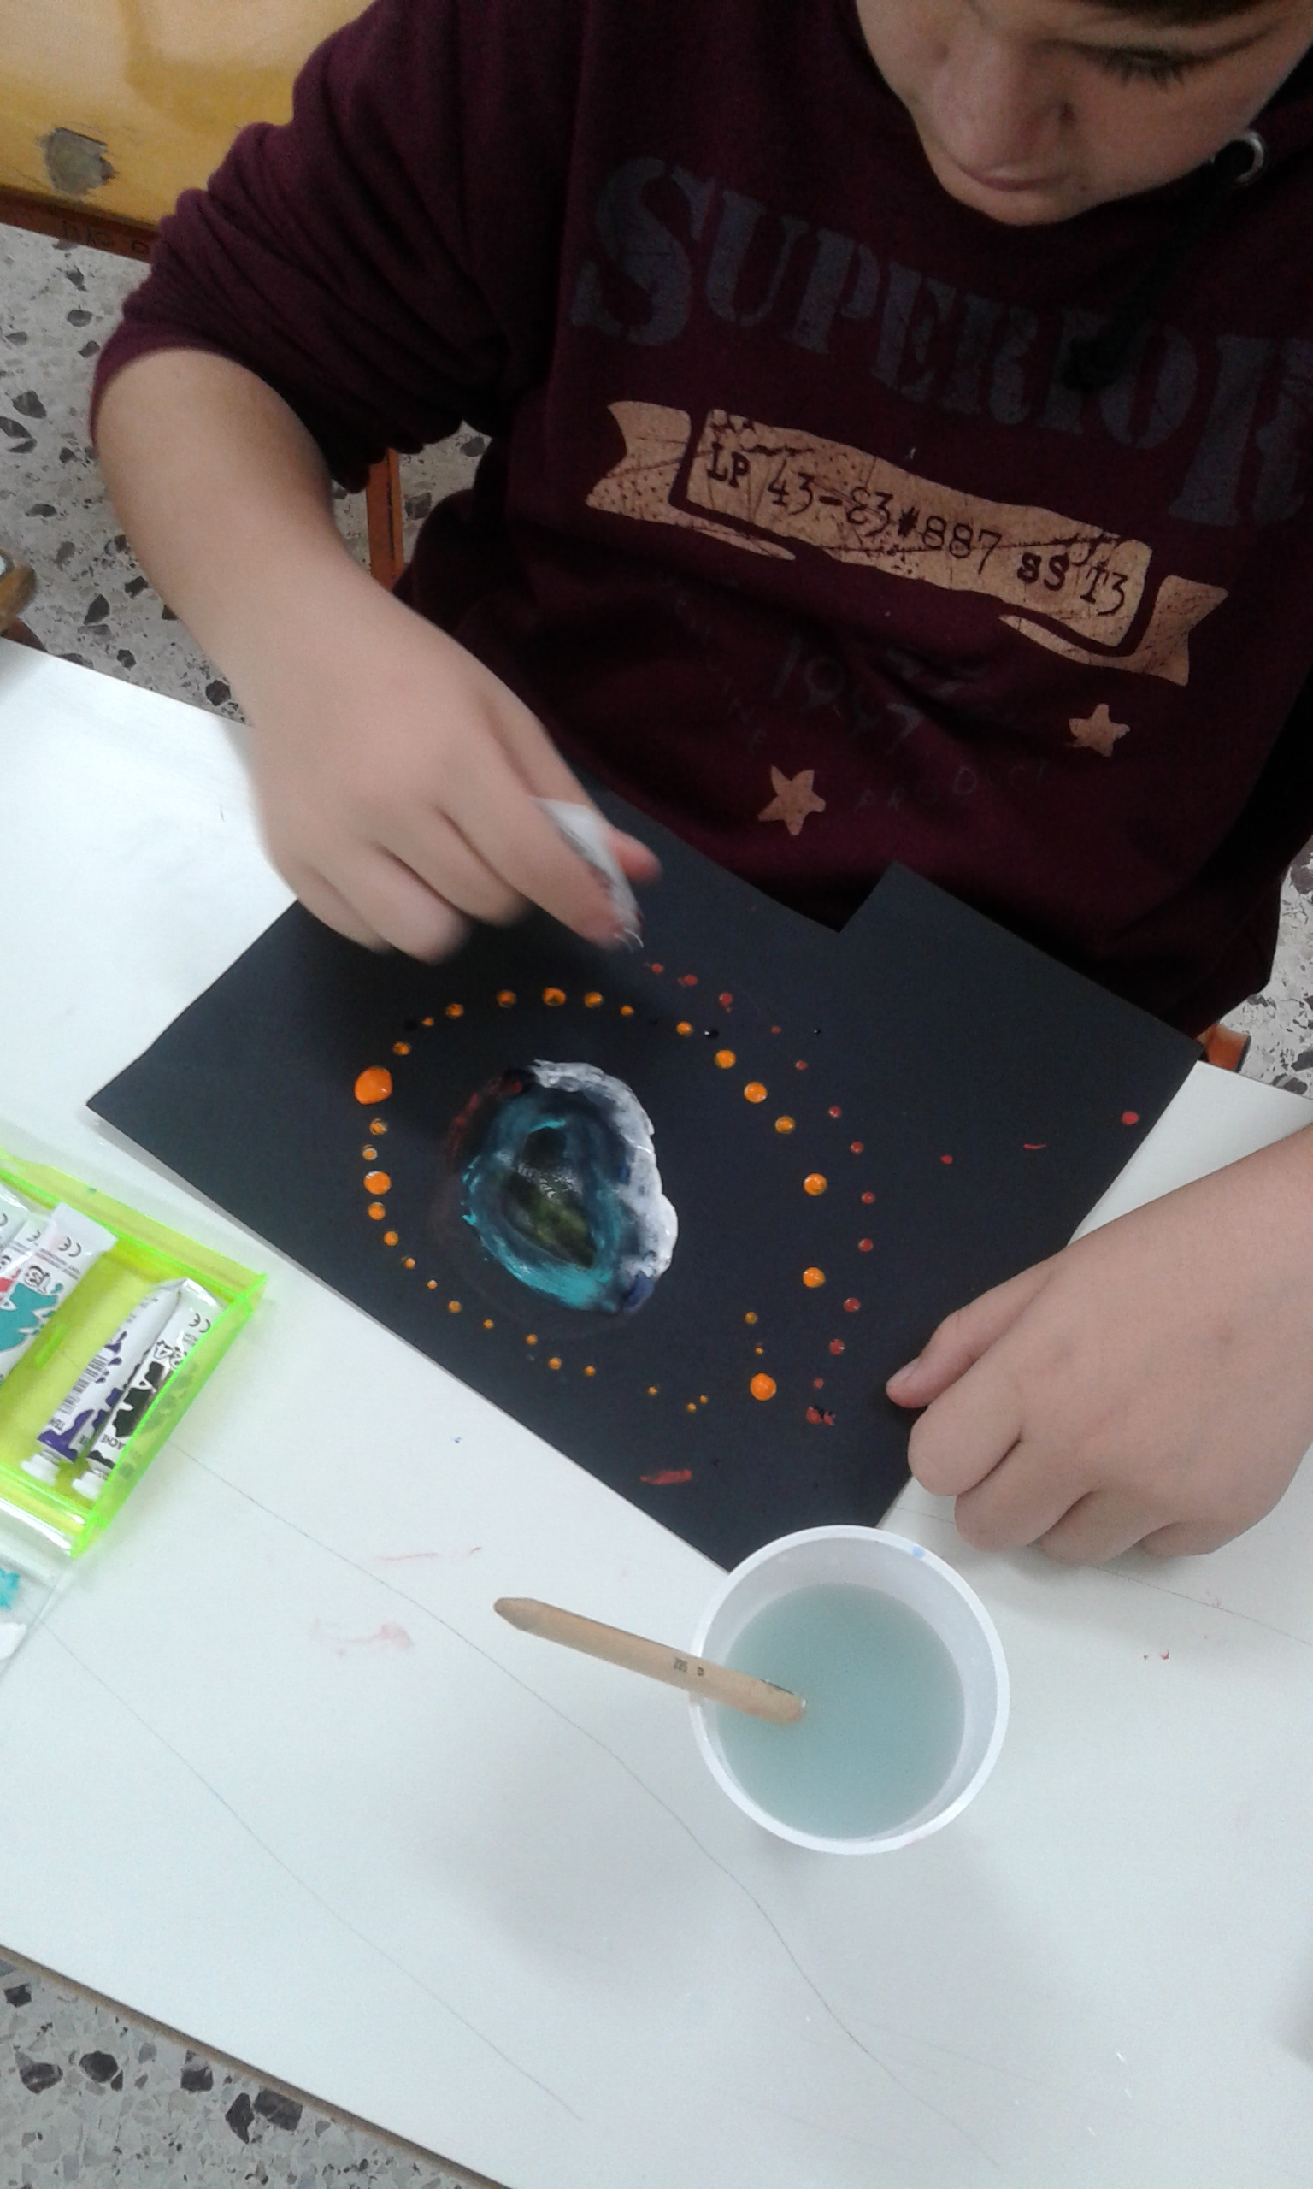
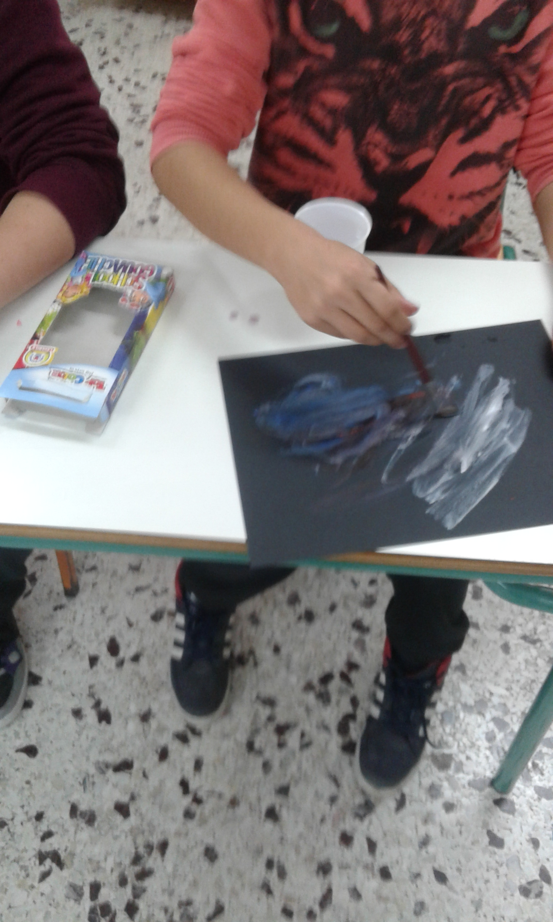
Drawing the big bang

Slide 8
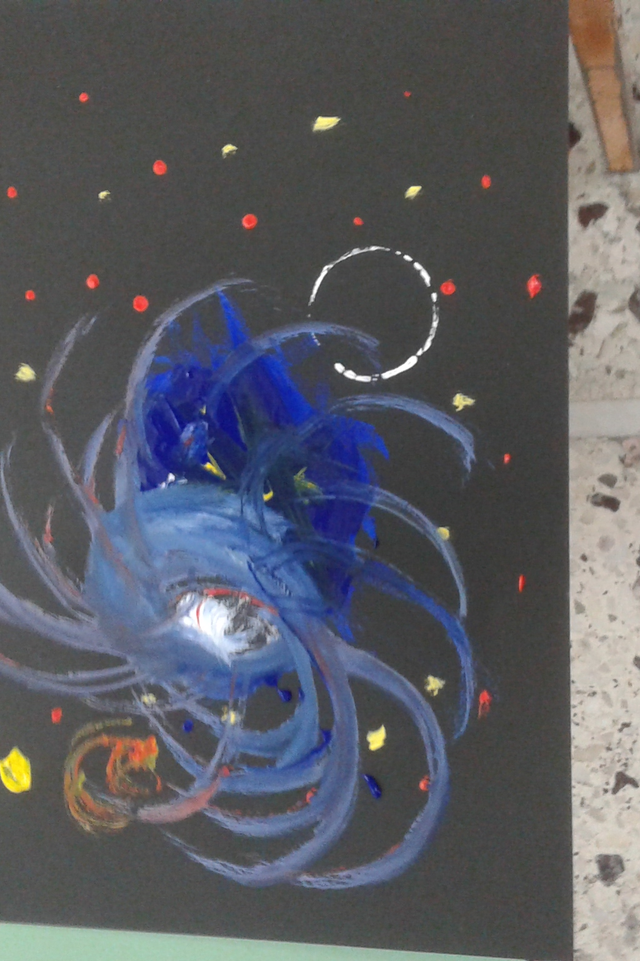
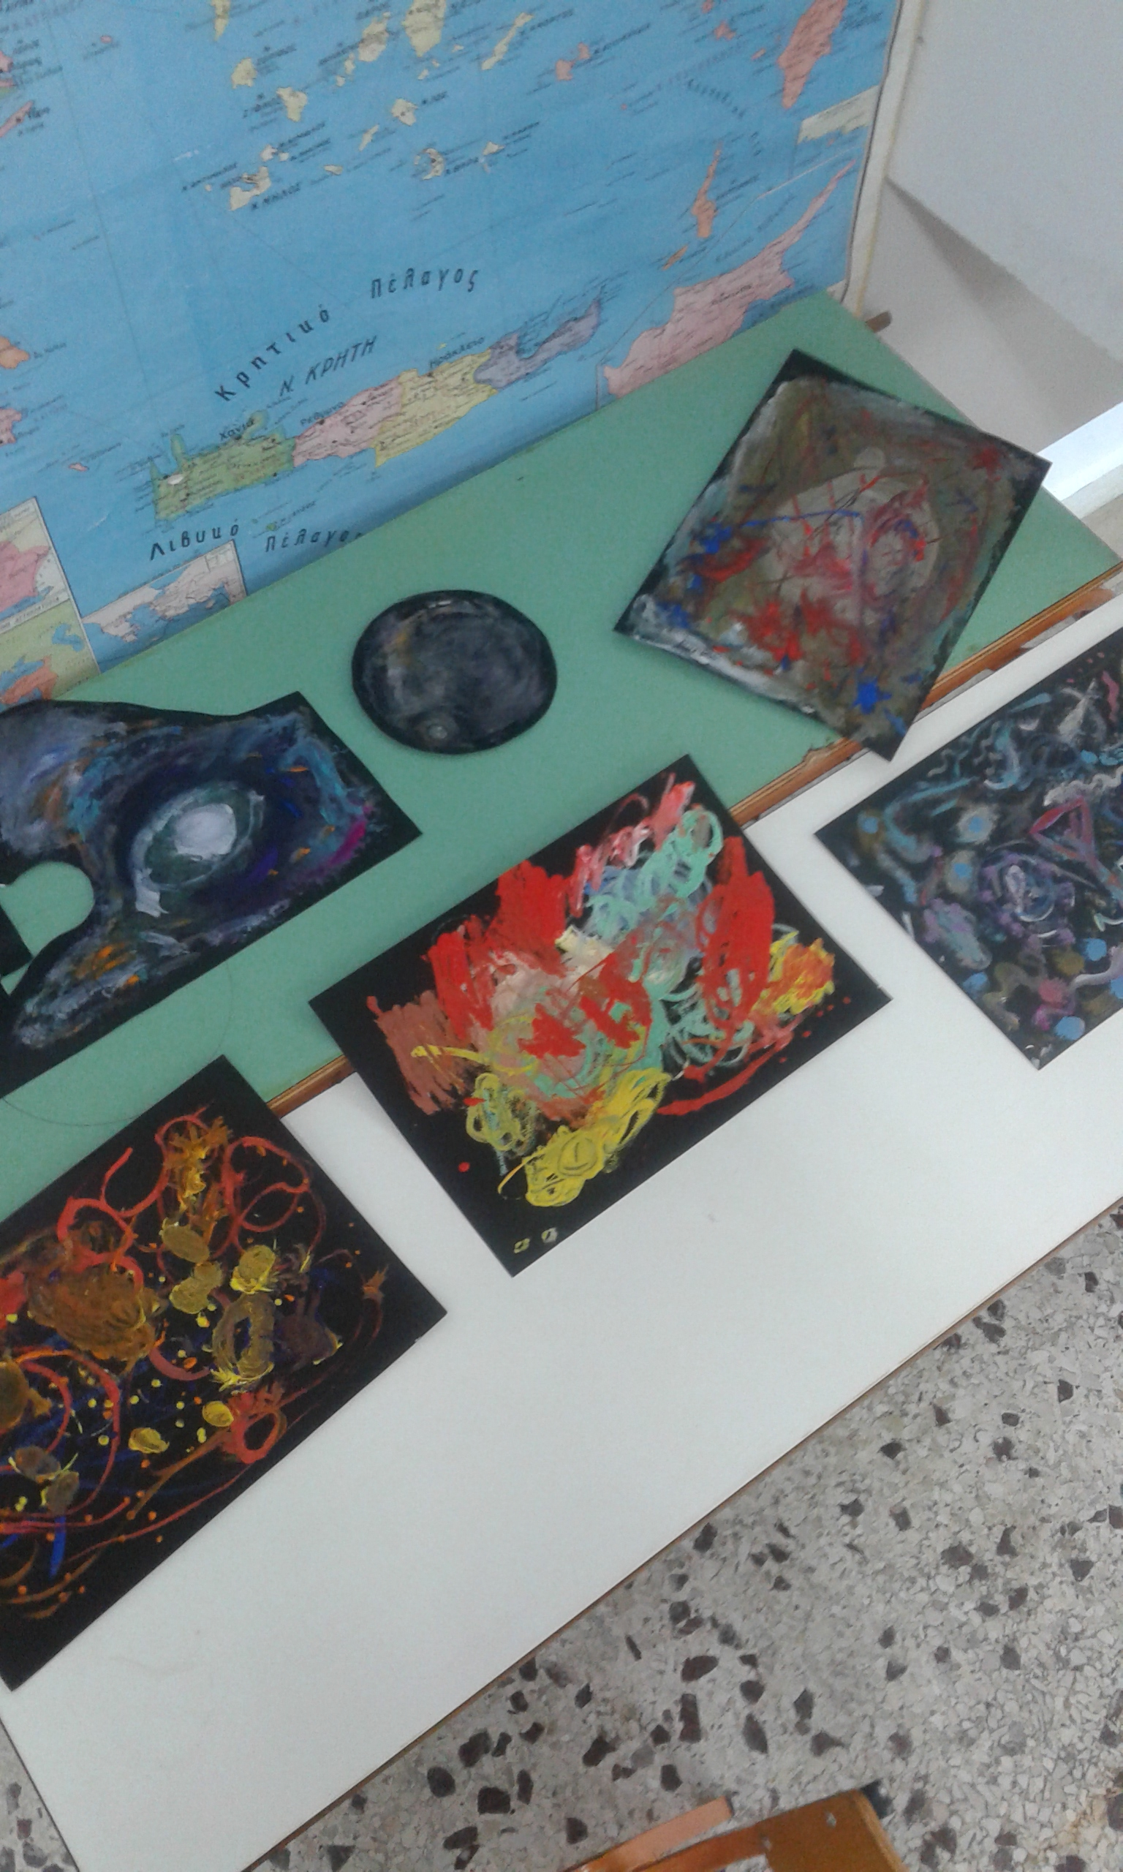
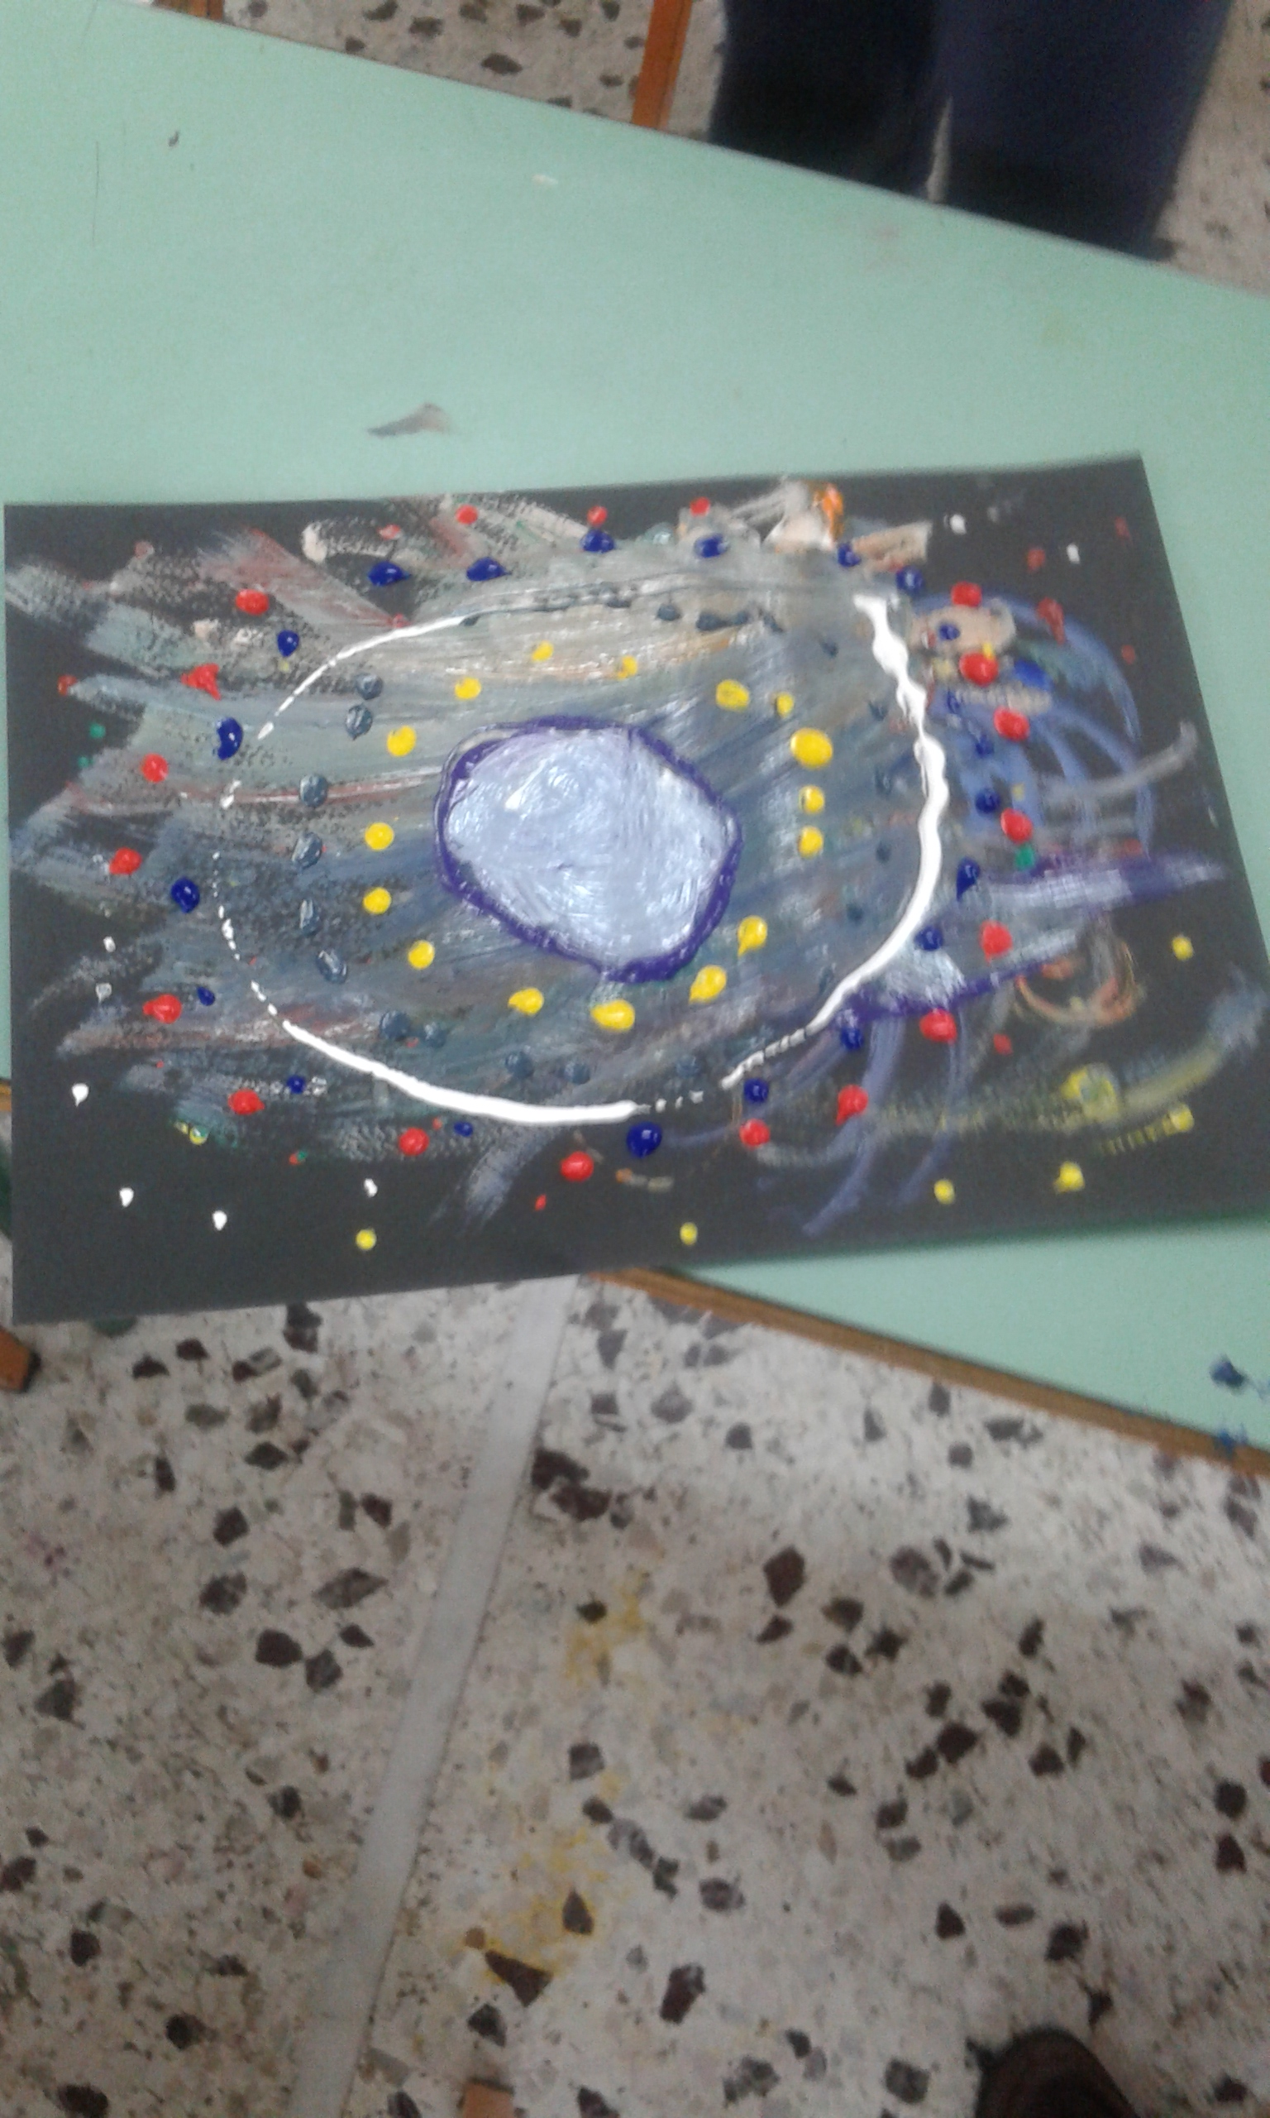

Slide 9
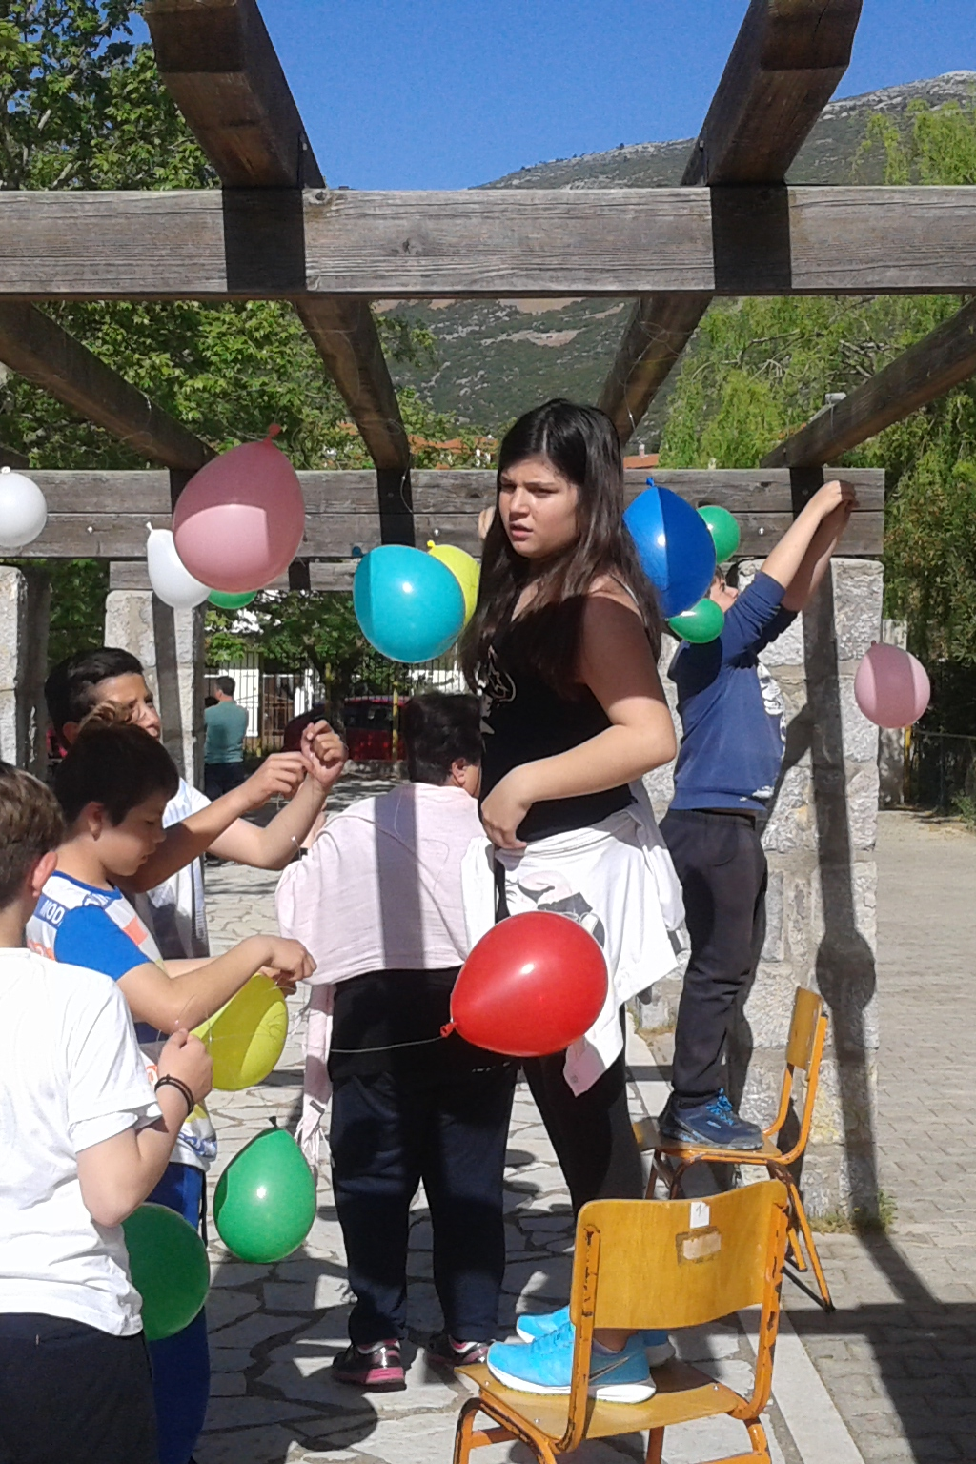
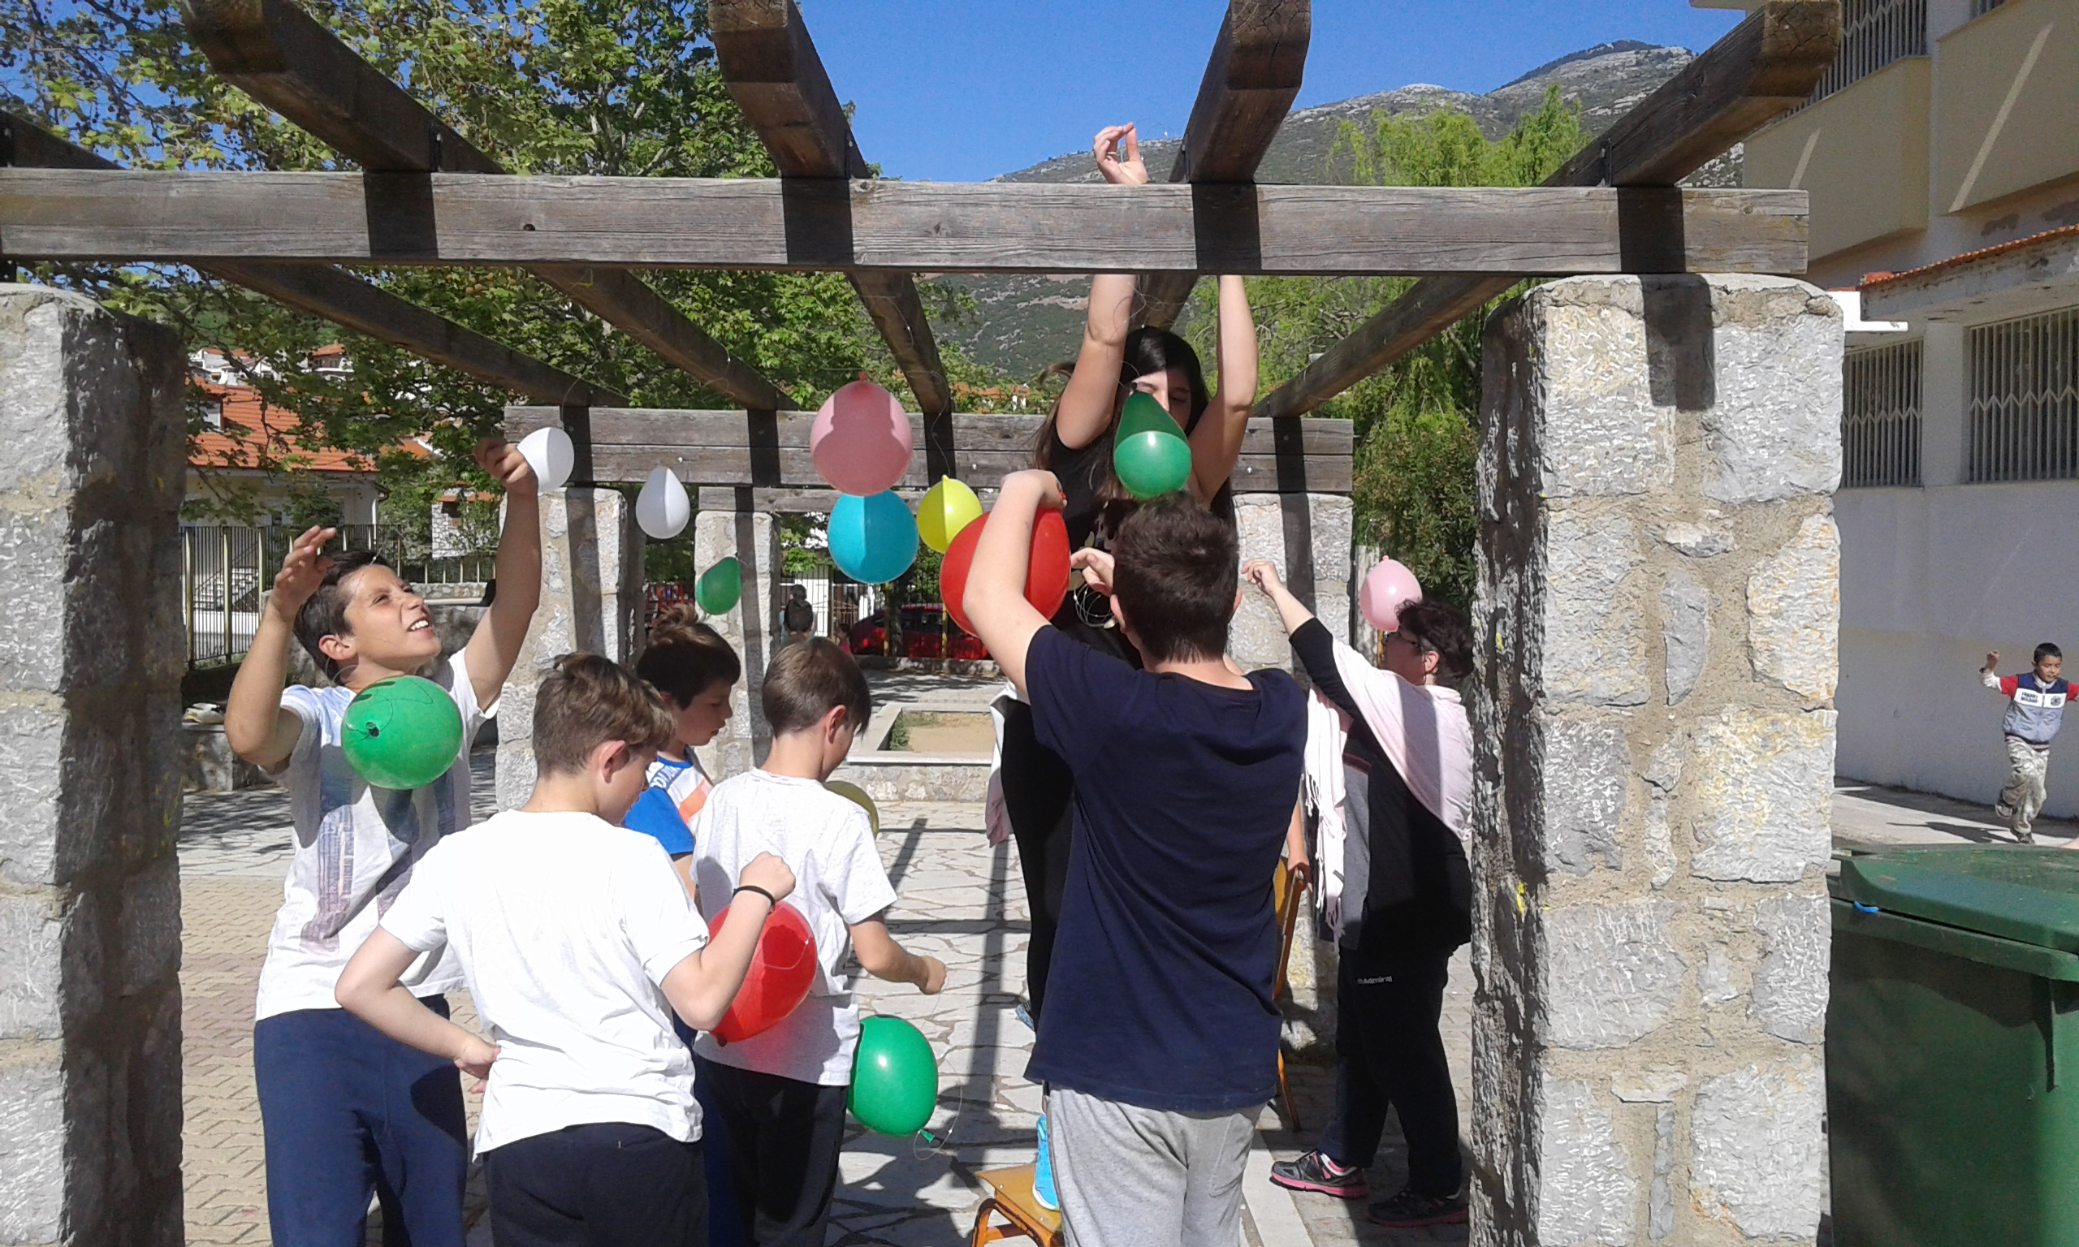
Preparing the scene

Slide 10
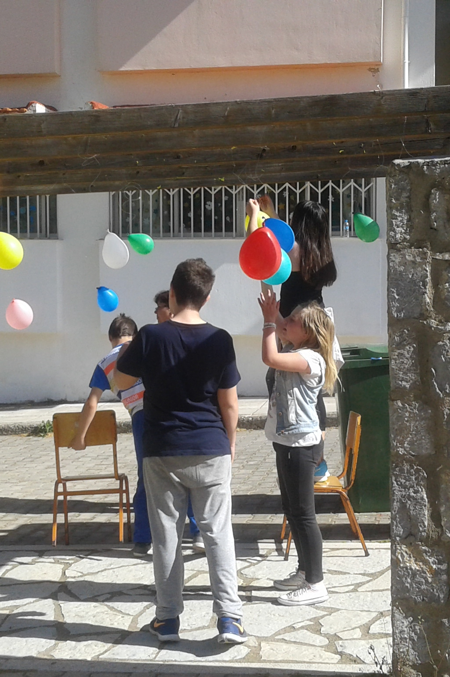
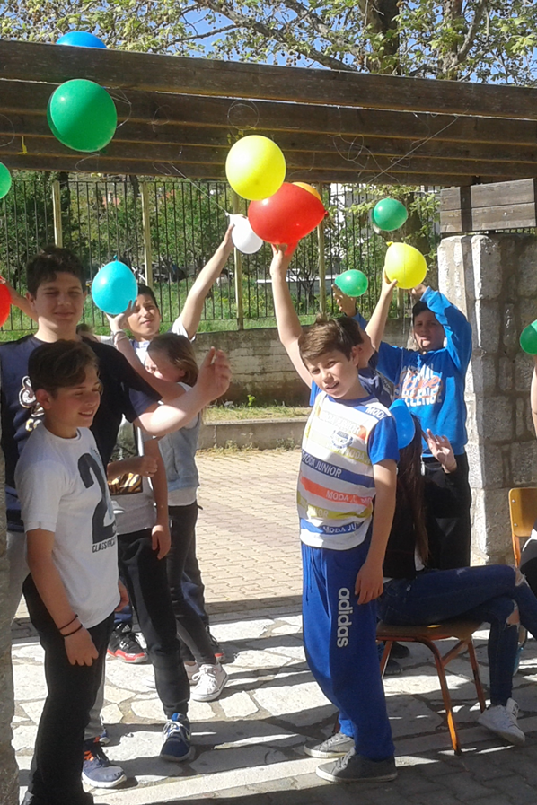

Slide 11
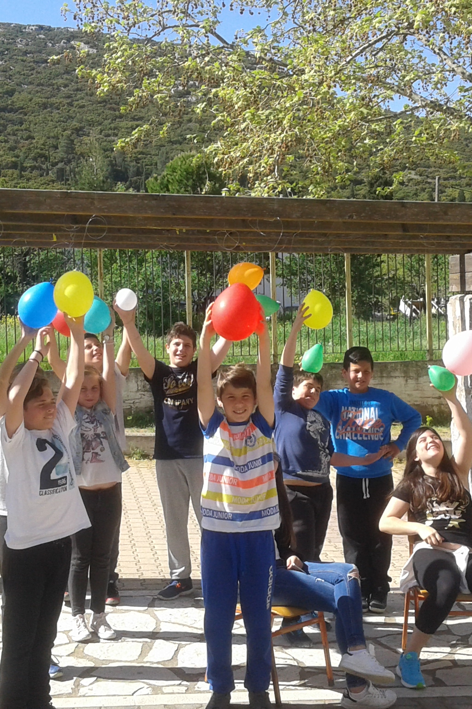
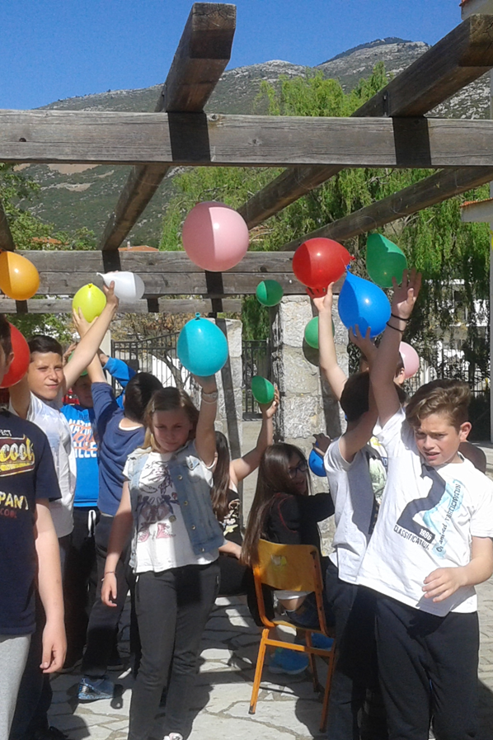

Slide 12
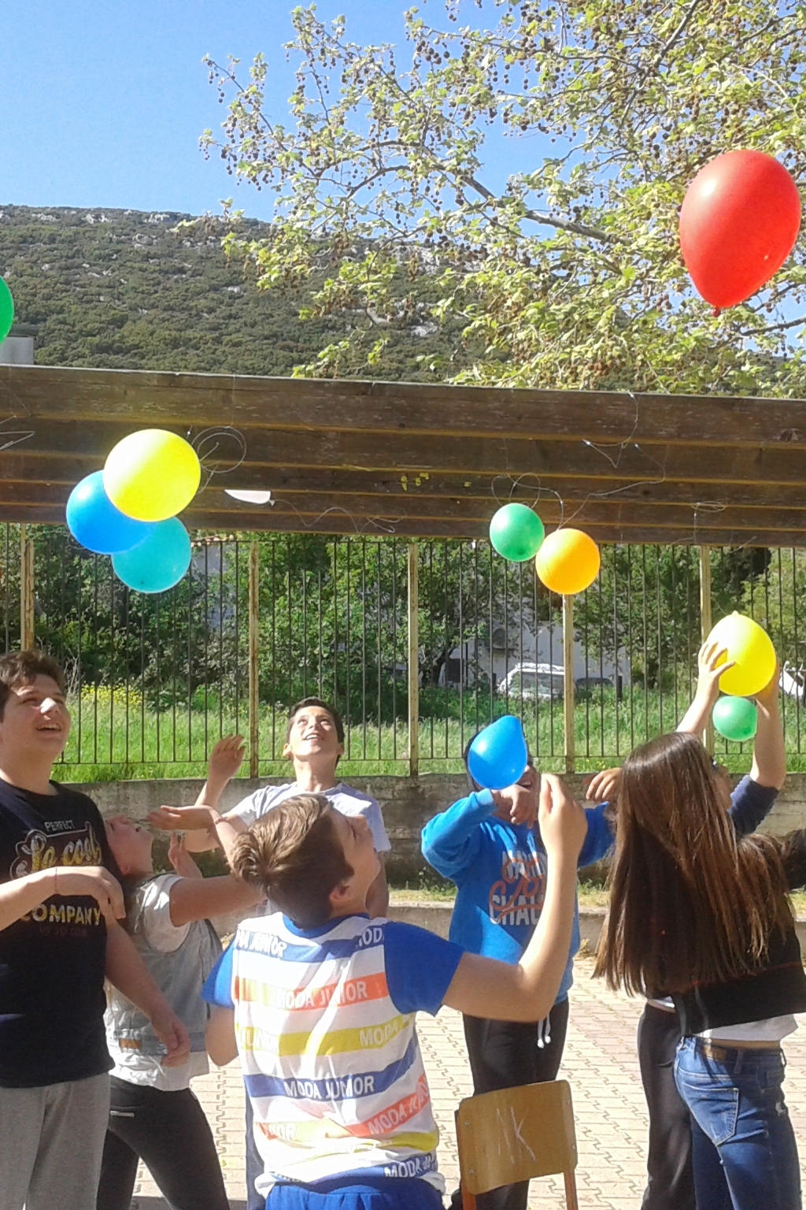

Slide 13
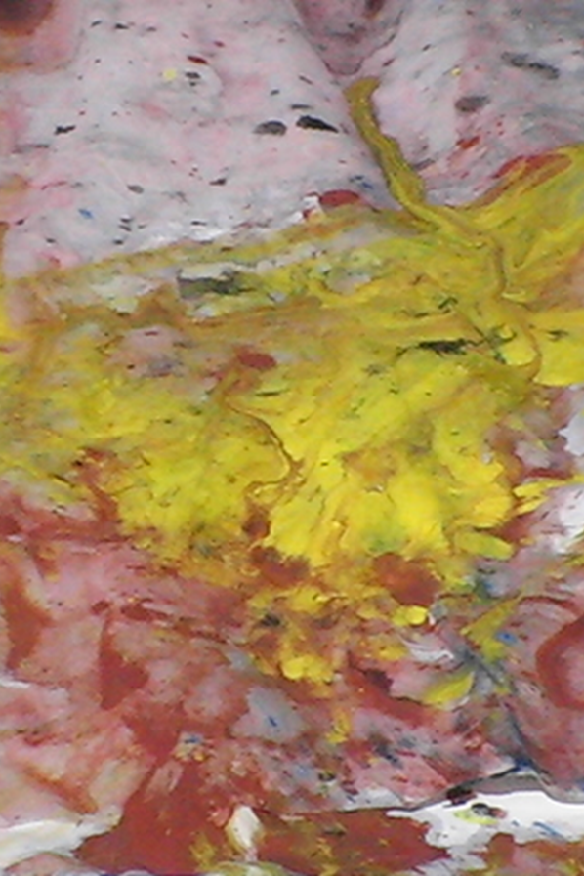
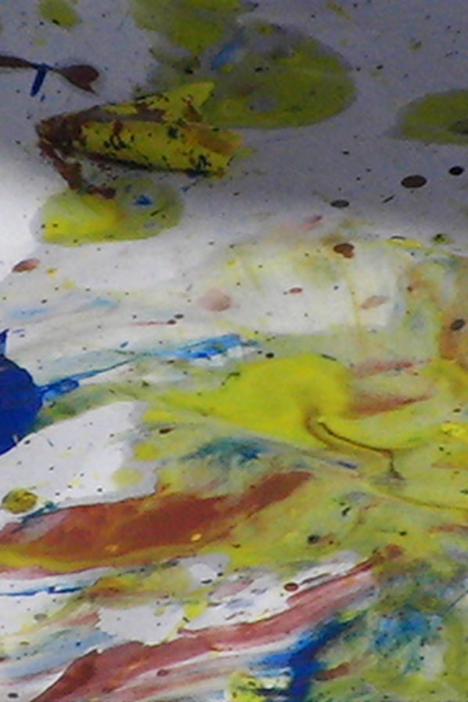

Slide 14
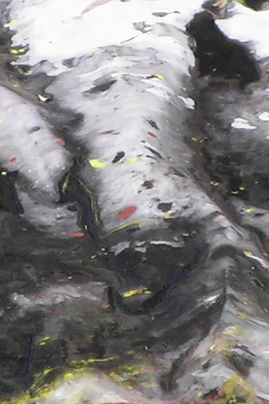
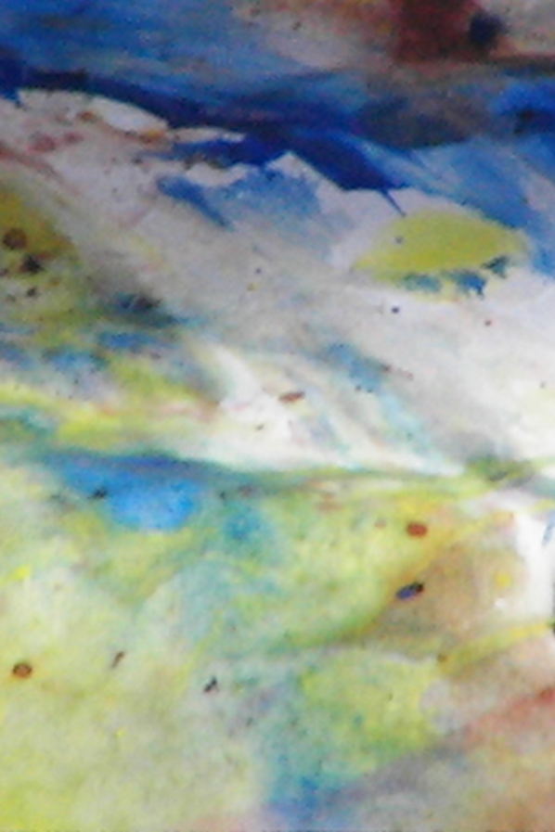

Slide 15
Thank you for your attention!

