Slide 1

Black Holes in My School

Slide 2
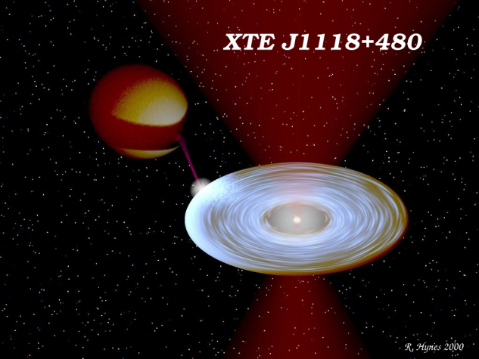
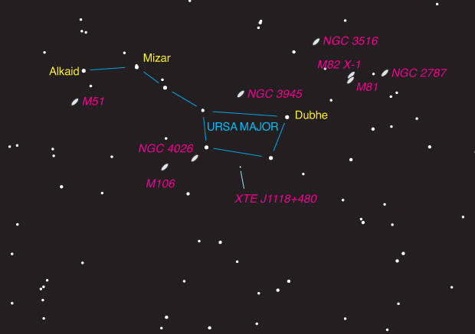
We will study a series of 62 images taken with the Faulkes Telescope

Slide 3
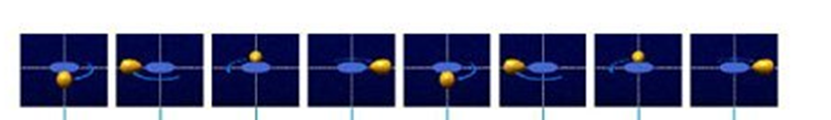

Slide 4
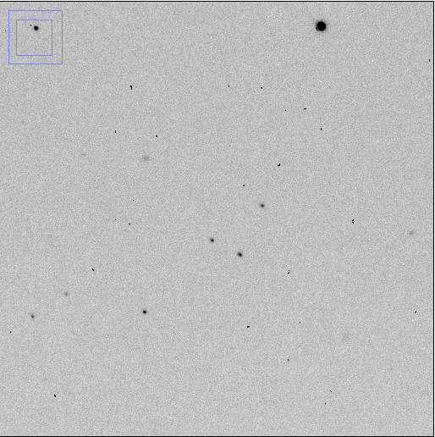
Measure the intensity of the 4 marked stars (using an apperture of 6) and insert the values in the excel spreadsheet and produce a plot of intensity x MJD
(Julian day is the continuous count of days since the beginning of the Julian Period, MJD is defined relative to midnight, rather than noon.)
Star 2
Star 1
Star 3
Star 4

Slide 5
Which star would you say has a light curve that exhibits variability?
Would you say that the light curve you observe resembles the light curve of a compact object in orbit around a star?

Slide 6
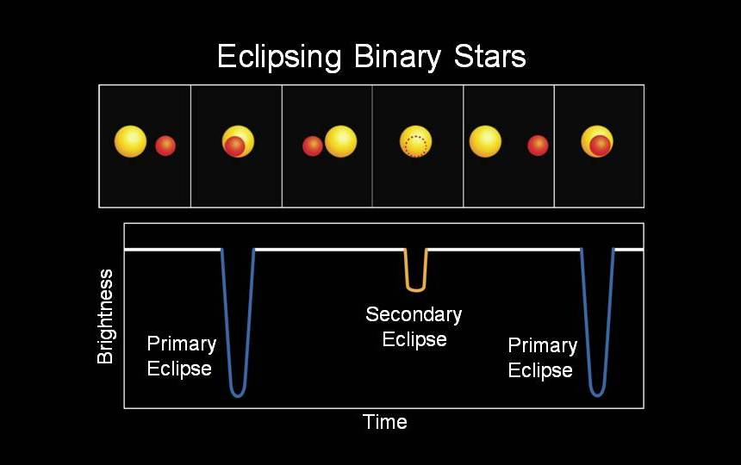
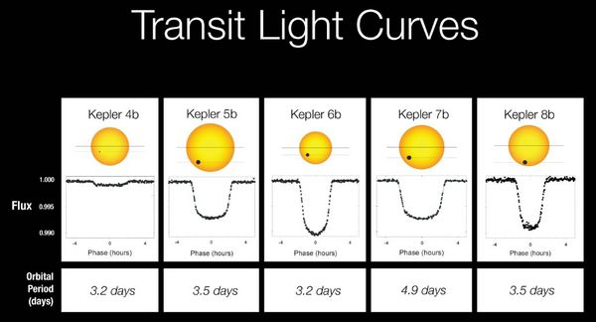
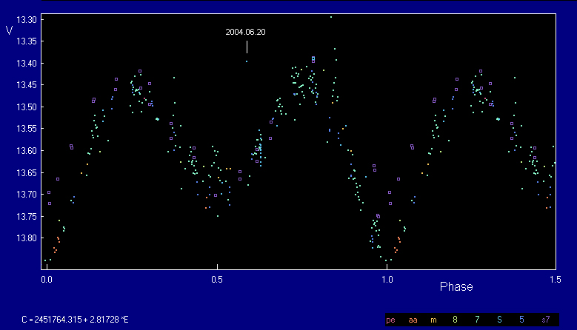
Ellipsoidal light Curve in a binary system

Slide 8

In order to have a clearer view you can now plot intensity x phase. To calculate the phase use the following formula:
$Phase= \frac{MJD−T0}{Period}$
Period =0.17 days = 4.08 hours = 14688
Where T0 is the first value of MJD in your table

Slide 10
You can further clean the data by dividing the intensity of the black hole candidate system by the average of the 3 stars

Slide 11
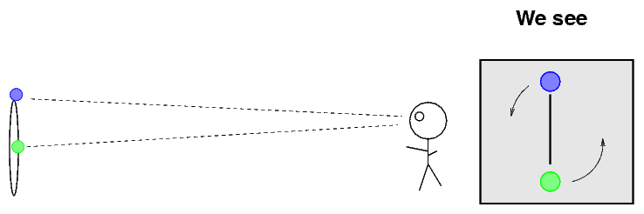
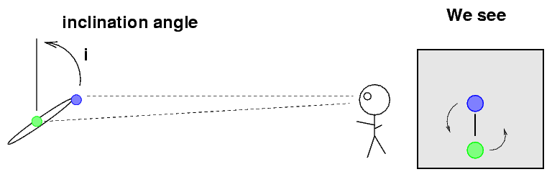

Once we know the period (0.17 days = 14 688 seconds) we can proceed to calculate the limiting mass of the black hole candidate using Newton’s modification of Kepler 3rd law:
$f\left(M\right)= \frac{{M_{1}}^{3}{\sin{i}}^{3}}{{(M_{2}+M_{1})}^{2}}=\frac{P{K_{2}}^{3}}{2πG}$ ~ 6.3 Msol
Where M1 is the mass of the compact object, M2 is the mass of the companion star (~6.1 solar masses), K the radial velocity determined by spectroscopy (700 km/s) , G the gravitational constant, and finally I is the inclination of the orbital plane of the system with the line of sight of the observer (which we will assume to be the maximum value 90º → sin i = 1)

Slide 12
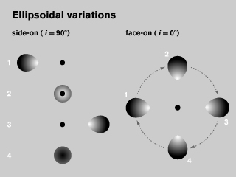
© Yale University

