Slide 1
Open Discovery Space
National Coordinators’ Meeting, Belgrade, 30/9/2013
T5.3 Controlled Pilot Trials
Sofoklis Sotiriou, Eleni Chelioti (EA)

Slide 2
 | Phase A Analysis of Demand and Requirements | Phase B (WAVE I) Pilot Implementation |  | Phase C (WAVE II) Large Scale Validation
 |  | B1 | B2
Number of Schools | 100 | 100 | 600 | 2,000
Countries | Greece, The Netherlands, Finland, France, Germany, Austria, Italy, UK, Portugal, Latvia, Estonia, Lithuania, Belgium, Ireland, Spain, Croatia, Cyprus, Bulgaria and Greenland. | Greece, The Netherlands, Finland, France, Germany, Austria, Italy, UK, Portugal, Latvia, Estonia, Lithuania, Belgium, Ireland, Spain, Croatia, Cyprus, Bulgaria, Greenland, Turkey, Poland, Hungary, Romania and Serbia |  | All European countries
Time frame | April 2012 to December 2012 (M1-9) | January 2013 to April 2013 (M10-13) | September 2013 to June 2014 (M18-25) | September 2014 to February 2015 (M30-35)
Phase B – involvement of 500 additional schools that will be involved in the pilots, WP5 (9 months duration)
Phase C – involvement of additional 1400 schools in the framework of the large-scale validation activities, WP11 (9 months duration).

Slide 3
What is ODS offering to schools in Pilot Phase 2?
School assessment and development tools:
  E-maturity questionnaire for new schools. Old schools will complete it afresh after the completion of Pilot Phase 2
  Action plan- Old schools may want to update it
Self-assessment and professional development tools for teachers:
  Registration of the teachers to the ODS portal and self-assessment of their competence profile
Participation/ setting up of communities and uploading/ sharing of educational materials:
  At school level (individual school communities)
  At national level (e.g. Community of Irish schools, Community of Greek Pilot schools etc).
  Thematic international communities and sharing of material (e.g. 3-d Printing Community, “Let’s share the Music, Let’s link the world” community)
Training:
  Training Academies
  Implementation of existing scenarios and design of new scenarios-> development of educational design skills and application of innovative teaching/ learning models
  Participation in change management skills workshops for the change-agent teachers
  Participation in practice reflection workshops
  Participation in other training activities organised locally or internationally
  Opportunities for attending Summer and Winter schools
  Participation in ODS challenges/ contests (WP11)

Slide 4
Current status of school participation
 |  | Schools |  | Teachers | Students
 |  | Phase B1 | Phase B2
1 | Austria | 9 | 9 | 9 | 245
2 | Belgium | 20 | 20 | 20 | 160
3 | Bulgaria | 18 | 18 | 79 | 3745
4 | Croatia | 9 | 9 | 47 | 671
5 | Cyprus | 7 | 12 | 39 | 252
6 | Estonia | 10 | 10 | 17 | 414
7 | Finland | 10 | 10 | 95 | 208
8 | France | 10 | 16 | 18 | 333
9 | Germany | 2 | 2 | 4 | 60
10 | Greece | 25 | 44 | 140 | 1362
11 | Greenland | 6 | 6 | 6 | 60
12 | Ireland | 14 | 14 | 8 | 80
13 | Italy | 7 | 7 | 62 | 500
14 | Latvia | 10 | 10 | 14 | 155
15 | Lithuania | 5 | 5 | 5 | 135
16 | Netherlands | 8 | 18 | 25 | 265
17 | Portugal | 10 | 16 | 23 | 509
18 | Romania | 7 (B2 Entry) | 9 | 9 | 90
19 | Serbia | B2 Entry | 46 | 46 | 400
20 | Spain | 9 | 13 | 26 | 140
21 | UK | 43 | 43 | 47 | 400
22 | Hungary | B2 Entry
23 | Poland | B2 Entry
24 | Turkey | B2 Entry
 | Total | 240 | 337 | 739 | 10184
Increase in 7 countries
Most of the countries that have not updated their school rates are in the process of contacting the schools
Some countries have not responded at all

Slide 5
Submission of e-maturity q/res & Action plans- Production of school profiles
 |  | No. of schools- Phase 2 | E-maturity q/res | Action plans | School profiles
1 | Austria | 9 | 1 | 1 | 4
2 | Belgium | 20 | 10 | 3 | 3
3 | Bulgaria | 18 | 108 | 18 | 18
4 | Croatia | 9 | 9 | 9 | 9
5 | Cyprus | 12 | 6 | 6 | 6
6 | Estonia | 10 | 0 | 10 | 10
7 | Finland | 10 | 5 | 5 | 5
8 | France | 16 | 9 | 9 | 6
9 | Germany | 2 | 8 | 2 | 2
10 | Greece | 44 | 41 | 21 | 26
11 | Greenland | 6 | 6 | 0 | 0
12 | Ireland | 14 | 8 | 8 | 8
13 | Italy | 7 | 9 | 7 | 7
14 | Latvia | 10 | 0 | 10 | 10
15 | Lithuania | 5 | 6 | 5 | 5
16 | Netherlands | 18 | 9 | 8 | 8
17 | Portugal | 16 | 9 | 10 | 8
18 | Romania | 9 | 7 | Phase 2 Entry | Phase 2 Entry
19 | Serbia | 46 | 46 | Phase 2 Entry | Phase 2 Entry
20 | Spain | 13 | 14 | 4 | 3
21 | UK | 43 | 6 | 3 | 1
22 | Hungary | Phase 2 Entry | Phase 2 Entry | Phase 2 Entry | Phase 2 Entry
23 | Poland | Phase 2 Entry | Phase 2 Entry | Phase 2 Entry | Phase 2 Entry
24 | Turkey | Phase 2 Entry | Phase 2 Entry | Phase 2 Entry | Phase 2 Entry
 | TOTAL | 337 | 317 | 139 | 139
Notes:
The overall number of schools is the updated one, but the numbers or q/res, action plans, and school profiles reflect in reality phase 1 only- so it is expected that these numbers are currently lower. But there was missing info, even during phase 1 from many schools. Some remarks: Not all the schools have completed the q/re- and vice versa, in some countries there were schools that only filled it in, but did not submit an action plan. As a result, we could not produce the school profile. 2) the quality of the action plans was sometimes poor- lots of missing inf, so the NCs should make sure that all the fields are covered and make sense. 3) Some action plans from the same country were identical

Slide 6
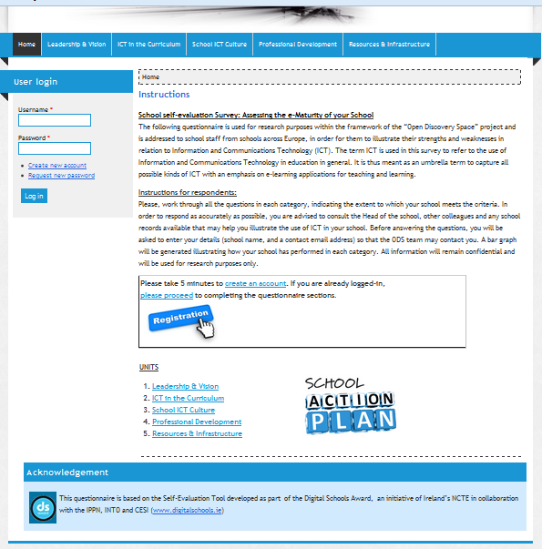
Digital form of e-maturity questionnaire work progress
Translations sent by almost all partners- Finnish is pending
Ready: English, French, German, Portuguese, Spanish, Croatian, Romanian, Bulgarian, Serbian, Lithuanian, Serbian, Dutch
Notes:
6 more languages to do- The translation in Finnish is missing!

Slide 7
Distribution of work for the collection of action plans and production of school profiles
NCs: Collect action plans from schools and produce the school profiles.
Partners contributing in collecting action plans and school profiles from NCs, ensuring also their quality:
  UBT: Germany, Austria, Finland, Greenland & France
  BG NRN: Bulgaria and Romania
  MIKSIKE: Estonia, Latvia, Lithuania
  EA (task leader): Collects input from the above + Belgium, Croatia, Cyprus, Greece, Ireland, Italy, Netherlands, Portugal, Spain, UK, Hungary, Poland, Turkey)

Slide 8
Local & international implementation activities
Already organized or planned:
Country | Title | Organized by | Date(s) and Location | Number and status of participants | Link
Greece | "Good morning Mr Higgs" | 1st Primary School of Portaria, EA & CERN | October 2013- April 2014 |  | http://science4primaryschooleducators.webnode.gr/
Serbia | Teacher-training conference for pilot schools in ODS | BMU | September 30, 2013 - Beograd | 80-90 teachers from ODS pilot schools | http://ods.metropolitan.ac.rs/konferencija-za-nastavnike-ucesnike-pilot-faze/
International | Training workshop for Science and Astronomy teachers | GTTP & European Astronomy Association | November 25th to 29th, Netherlands, Leiden |  | http://www.esa.int/Education/Teachers_Corner/ESA_GTTP_Teacher_Training_Workshop_2013_apply_now
UK | Series of workshops around the UK on using robotic telescopes for Science & Astronomy teaching | LIVJM | October 4th (Edinburgh), November 15th (London), December 6th (Devon) | 25 teachers/ workshop | http://www.schoolsobservatory.org.uk/teach/training
Google-doc for collecting implementation/ training activities: https://docs.google.com/spreadsheet/ccc?key=0ApycOBlBm8ObdHZDQjRPRThqd1IxMV9IUFk3elE5clE#gid=0

Slide 9
Recommendations for motivating schools
Organise national contests for best educational scenarios in various curriculum areas (use of ODS tools and templates for the scenarios + enrichment of the scenarios). The award can be free participation in training events, e.g. Summer or Winter Schools.
Encourage schools to participate in ODS international contests.
Bring neighbouring schools or schools with similar interests together- give them ideas for collaborative activities, school visits and exchanges.
Locate schools that can act as “mentors” for others.
Locate schools that are interested in international collaboration and offer opportunities for visit exchanges.
Share school practices and activities with the other NCs.

Slide 10
Workshops for Change-Agent teachers (T3.5)

Slide 11
Partners involved
Country | National Coordinators
Greece | EA (Task leader)
 | PI
Finland | JYU
 | UHelsinki
Austria | BMUKK
 | UNIVIE
Italy | UNITS
 | UNISG
UK | LIVJM
Portugal | NUCLIO
Latvia | MIKSIKE
Estonia | MIKSIKE
Lithuania | METIS BALTIC
Belgium | KHLim
Ireland | ULS
Spain | UCA
Cyprus | DIGIPRO
Bulgaria | BG NRA
Romania | SIVECO
Serbia | BMU

Slide 12
GOALS
Development of an intensive training programme to involve ODS change-agent teachers in highly interactive, simulation based workshops through which:
  They will be familiarized with different forms and types of resistance to change
  They will develop a successful change implementation strategy by deploying different management tactics.

Slide 13
What is the mission of the change-agent teacher?
A pioneering teacher who leads the team of the participating teachers from each school, and:
  takes initiative in order to implement innovative practices that aim to have long-term effect on the development of the school as a whole.
  Develops a strategy for involving and disseminating the results of innovative practices to the whole school community
  Develops a strategy for dealing with resistance to change

Slide 14
The task includes:
Creating a “simulation scenario” and adapting it to specific target groups and specific needs
Designing a customizable structure for a) workshop, b) debriefing session (f2f or online)
Running the workshops and collecting reports
Setting up a community of change agent teachers on the ODS portal -> Ongoing support to teachers
OUTPUT: D3.3 “Teachers as Leaders of Change Workshop Report and Learning Experience Package” – M24

Slide 15
Workshop scheduling
Sets of 2 workshops (1st session and follow-up). At least one set in each country.
Time frame: November 2013 – mid January 2014- Workshop reports must be submitted by January 31st.
The change management workshops should take place before the Practice Reflection Workshops.
 |  |  |  |  |  |  | Change agent workshops |  |  | Practice reflection workshops
M13 | M14 | M15 | M16 | M17 | M18 | M19 | M20 | M21 | M22 | M23 | M24 | M25 | M26 | M27 | M28 | M29 | M30 | M31 | M32 | M33
Apr | May | Jun | Jul | Aug | Sept | Oct | Nov | Dec | Jan | Feb | Mar | Apr | May | Jun | Jul | Aug | Sept | Oct | Nov | Dec

Slide 16
Development of ‘simulation scenario’ ?
A simulation scenario is a standardized software-based story, in which the participants deal with various challenges= Quantitative outcome
We suggest…
A more open- ended approach given:
  Wide range of situations, contexts, cases, practices and policies across ODS countries.
  Wide range of teachers’ profiles and competences
i.e. A video with teachers’ interviews that covers different types of resistance coming from different forces/ actors (e.g. from school managers/ colleagues/ parents/ external actors =
A series of cases that will intrigue discussion, sharing of experiences and looking for solutions (less standardized approach that is customizable to different national contexts)

Slide 17
Description of video
Duration: approx. 20 minutes
2-3 interviewees from different countries
Various cases of teachers:
  e.g. working in public and private schools, primary and secondary education,
  Different types of schools (general, vocational, special needs etc).
Different types of resistance to change, i.e.
  External (community, policy issues), internal (school management, peers), aggressive resistance, passive resistance etc.
Different countries
Topics to be covered in the interviews:
  Teachers’ experiences in current or former schools of trying to change established patterns
  What was the need for change? Obstacles they faced- Where did they come from? How were they resolved? Was the change sustainable? Who did they ask for help?
The overall message should be positive- we are looking for success stories!!!
Tasks:
Interviewing teachers and recording
Editing the video
Translating in all languages
Subtitling
Time-frame for preparing the video: end of October 2013

Slide 18
Workshop outline (Session 1)
Duration: Approx. 3 hours
Participants: approx. 25- Groups of teachers from different schools
Number of Facilitators: 2
Introduction to the workshop and its objectives
Presentation of video: The participants will be asked to discuss in groups the various challenges and types of resistance that the video presents. The facilitator (NC) asks the following questions and makes poster notes:
  What types of resistance do you recognize?
  Have you faced or are you currently facing similar challenges in your school?
  How are you dealing with them?
  How would you react in a similar case?
  According to your experiences, what seems to work?
  Can we come up with a set of good practices in dealing with resistance to change? Can we identify a set of components that seem to work/ or could work in order to overcome resistance to change? ->This should create a list of factors that would foster educational change, e.g. building an environment of trust and safety, cooperation, building of self-confidence and self-awareness, having of a common vision, awareness of teachers’ roles as co-creators of a learning environment.
Work in groups- Designing a strategy for improving conditions that foster change: Each group fill focus on a different factor from the list that was previously identified, and will design a strategy on creating these conditions in their schools. Each group reports on their discussion. The facilitator makes poster notes. E.g. under “Building trust” the facilitator writes down the group’s ideas and suggestions for a strategy.
Overall suggestions on how can ODS further support change agent teachers & Presentation of ODS community for change agent support. A community on the ODS portal will be used for further exchange of materials, views and sharing of experiences. The facilitator presents the community.

Slide 19
Follow up session
Duration: Approx. 2 hours
Participants: The same as in Session 1
Number of facilitators: 2
Review of session 1, the factors identified by the group and the strategies they identified, e.g. building trust
Reflection on action:
    To what extent was the identified change/ intervention achieved?
    What obstacles did they face and how did they deal with them?
    How does each individual assess the outcome in their school?
    Who was benefited?
    Has the schools’ orientation to change shifted?
    What amendments in the course of action should be made in order to better meet the targeted change?
    What other needs for support did they identify?
    What are the next steps? Is the team ready to set new goals for further innovations?
  The facilitator makes notes for each one of these questions.
Agreeing on support and follow-through via the ODS portal: Reflection on how the ODS community of change-agent teachers is working; Presentation of materials uploaded (tools and resources) for further support of the teachers.

Slide 20
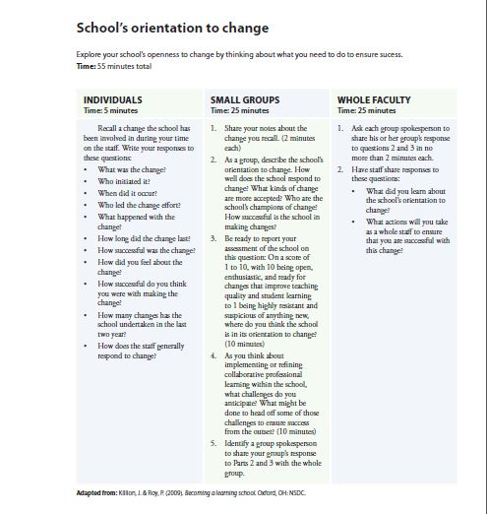
Other tools and resources to be used either during or after the workshops
  Mapping the school’s orientation to change
  (Killion & Roy, 2009- adapted by Armstrong, 2011)

Slide 21
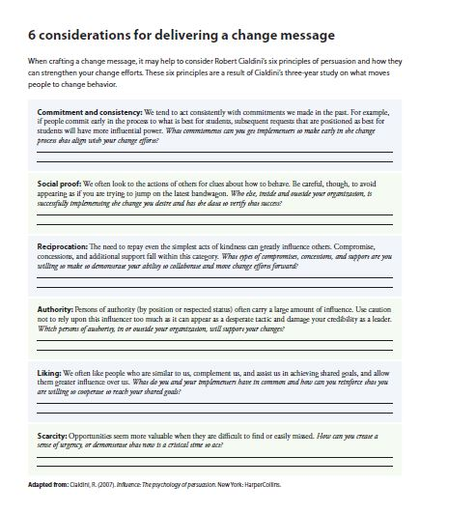
Other tools and resources to be used either during or after the workshops
Considerations for delivering a change message (Cialdini, 2007- adapted by Armstrong)

Slide 22
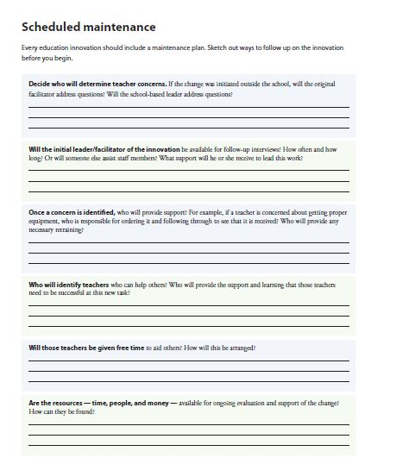
Other tools and resources to be used either during or after the workshops
Plan for maintaining innovation in the school (Armstrong, 2011)

Slide 23
Workshop reporting template
Session 1
Location of workshop, date, number of participants, status of participants (teachers or heads of schools) and names schools that they work at.
Which types/ forms of resistance were identified as more relevant to the participants’ experiences?
Which good practices for overcoming resistance to change were brought up during the discussion?
Which factors did the participants identify that foster openness to change?
For each one of these factors, what do the participants think that they can do in their schools to help overcome resistance to change? What strategies are they planning to adopt?
What other needs for support did the participants identify in order to overcome resistance?

Slide 24
Workshop reporting template
Follow-up session
Location and date
Number of participants
    To what extent was the identified change/ intervention achieved?
    Which strategies seem to be more effective? Please provide examples.
    What obstacles did the participants face and how did they deal with them?
    How did each individual assess the outcome in their school?
    Who was benefited?
    Has the schools’ orientation to change shifted?
    What amendments in the course of action did the participants discuss/ decide to implement in order to better meet the targeted change?
    What other needs for support did they identify?
    What are the next steps that they plan to take?

Slide 25
T2.2 Participatory Engagement Activities-
Practice Reflection Workshops
Practice Reflection Workshops (T2.2)

Slide 26
PR Workshops per country
 | Country | Minimum number of PR Workshops
1 | Greece | 8
2 | The Netherlands | 8
3 | Finland | 8
4 | France | 8
5 | Germany | 8
6 | Austria | 8
7 | Italy | 8
8 | UK | 8
9 | Portugal | 8
10 | Latvia | 4
11 | Estonia | 4
12 | Lithuania | 4
13 | Belgium | 8
14 | Ireland | 4
15 | Spain | 4
16 | Croatia | 4
17 | Cyprus | 8
18 | Serbia | 2
19 | Bulgaria | 8
20 | Greenland | 4
21 | Romania | 4
Change agent workshops |  |  | Practice reflection workshops
M20 | M21 | M22 | M23 | M24 | M25 | M26 | M27 | M28 | M29 | M30 | M31 | M32 | M33
Nov | Dec | Jan | Feb | Mar | Apr | May | Jun | Jul | Aug | Sept | Oct | Nov | Dec

Slide 27
Objectives= Lessons learnt so far from ODS implementation
What is the impact of the participation in ODS implementation activities and training (along with other activities) on: a) individual teachers, b) On the school?
How could the effectiveness of the training/ implementation processes be increased?
What are the necessary changes in the implementation activities in order to proceed?- Connection with/ Input for WP5 and WP11
How does the training meet the ODS aims? Are there suggestions to improve the mapping?
ALSO:
Share school activities and practices among schools
Discuss experiences

Slide 28
Who will participate
Approx. 25 participants:
  ODS teachers (Pilot Phase 1= present and share experiences from implementation activities and training- Pilot Phase 2= get motivated and are introduced into the ODS objectives and processes)
  Summer school participants from each country
  ODYSSEUS contest participants from each country
  Other stakeholders: Trainers, Policy makers, Curriculum designers, stakeholders involved in training/ implementation activities (e.g. museum educators, science centers’ representatives etc.)

Slide 29
NC’s role
Organising the workshops in cooperation with other national partners (where available)
Collecting reports and consolidating them into national reports
Consolidated reports will be sent to EA, UBT and BMUKK

Slide 30
Workshop outline
Approximate duration: 3 hours
Introduction to ODS and to workshop: Brief update on the ODS project and the aims of this workshop
Case study presentations
Who:
  Approximately 5 participants who have been chosen in advance and who have each been involved in different training/ piloting/ implementation activities as part of WP5
  Whilst listening to the case studies, the rest of the group work together in pairs or small groups to see whether themes are emerging from the case studies e.g. do many of the case studies refer to teacher role? student engagement? subject knowledge?
Theme analysis: Discussion in groups and elaboration with other participants’ examples
The ODS teacher: Based on the experiences discussed, participants create a (re)presentation of what it means to be an ODS teachers
Final discussions and recommendations: Challenges that were described as well as reflect on the emerging themes for both the impact of the ODS training and activities and the ODS teacher – Recommendations for further implementation of ODS activities.
Questionnaire for Immediate Impact (developed by WP2, WP5 and WP11) http://www.virtuelleschule.at/limesurvey/
For detailed guidelines see D2.2 “Specifications for the Organisation of Participatory Engagement Activities”

Slide 31
Reporting template
(to be filled in by the NCs)
Location of workshop, date, number of participants per status (teachers/policy makers/ trainers)
Description of the cases that were presented
Themes that emerged during group discussion
Representation of the ODS teacher as illustrated by the participants’ groups
Challenges identified and Recommendations

Slide 32
Reporting template
(to be filled in by the NCs)
Impact of participation in ODS
  On teachers:
    Training needs
    New teacher competences
    Collaboration with other colleagues
    Support and teachers’ connection with the school as a whole- the teacher as member of a learning community
  On the school – This data is also provided in the school action plans- Do we need it here again?
  On the educational system
    Reactions/ support from authorities and promotion of ODS
    Implications for other teacher training programmes
  Overall ODS approach: Similar data are also provided in the school action plans- Do we need it here again?
    Which pedagogical practices seem to be more effective?
    Are there indications that the school’s overall participation in ODS has an impact on:
      Classroom management
      Use of digital resources
      Assessment methods
  Recommendations for Validation phase

Slide 33
Recommendations
Keep detailed records (photos of poster notes, diagrams etc) to be able to complete the reporting template
Make sure you save time for the questionnaire completion at the end of the workshop
Make sure that you have hardcopies of the questionnaire

Slide 34
Thank you for your attention!
Any questions?

