Slide 1
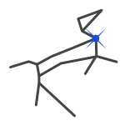

The School Telescope – a beginner’s guide
Neil Hawkins – Tring Astronomy Centre & Paul Hill Sirius Astronomy

Slide 2
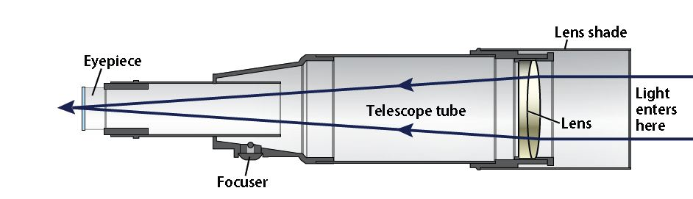
Telescope TYPEs - REFRACTOR
+ Contrast
+ Sharpness
+ Low Maintenance
- Cost per inch of aperture
- Colour correction issues

Slide 3
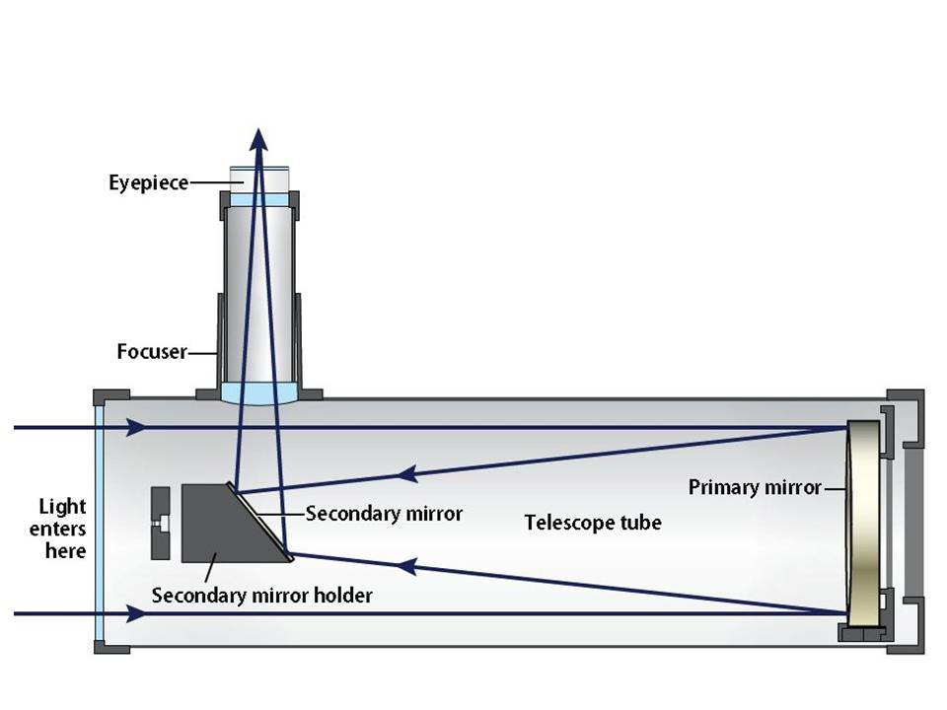
Telescope TYPEs - REFLECTOR
+ Low Cost
+ Good color correction
- Requires Collimation
- Physical Size
- Eyepiece at top of OTA

Slide 4
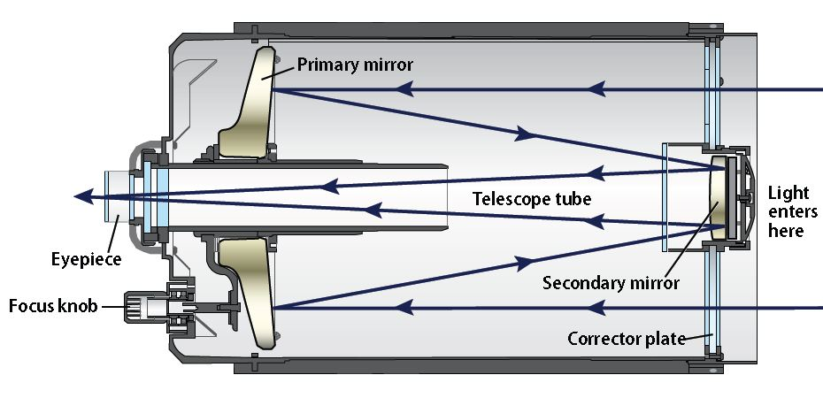
Telescope TYPEs – COMPOUND OR CATADIOPTRIC
+ Compact size
+ Medium cost
+ Lower Maintenance
- Longer focal length to aperture ratio

Slide 5
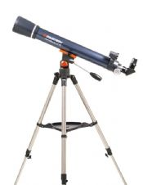
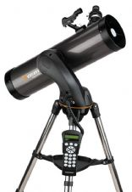
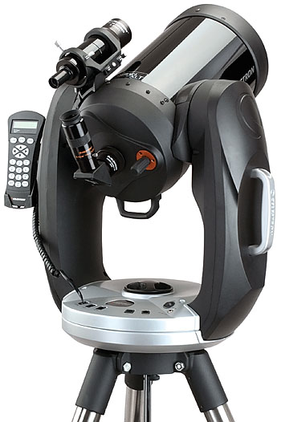
Telescope MOUNTS – ALT-AZIMUTH
+ Simple up down / left right operation
+ Light weight
+ Low cost
- You have to track by moving both axis
- Suffers image rotation effect

Slide 6
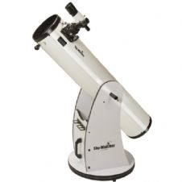
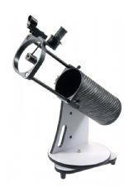
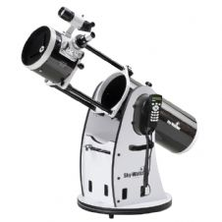
Telescope MOUNTS – DOBSONIAN (ALT-AZ)
+ Simple up down / left right operation
+ Light (ish) weight
+ Low (er) cost
- You have to track by moving both axis
- Suffers image rotation effect
- Needs a level surface

Slide 7
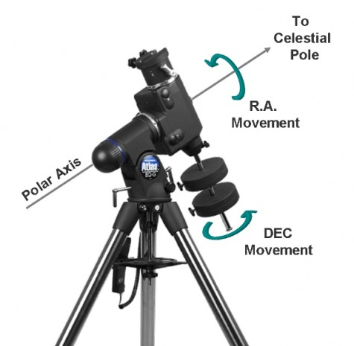
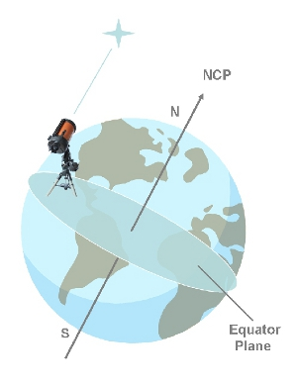
Telescope MOUNTS – EQUATORIAL
+ Mount can be aligned with Celestial pole
+ At the same time calibrates equatorial plane
+ No image rotation / track with one axis
- Heavy / needs counterweights
- More complicated
- More costly

Slide 8
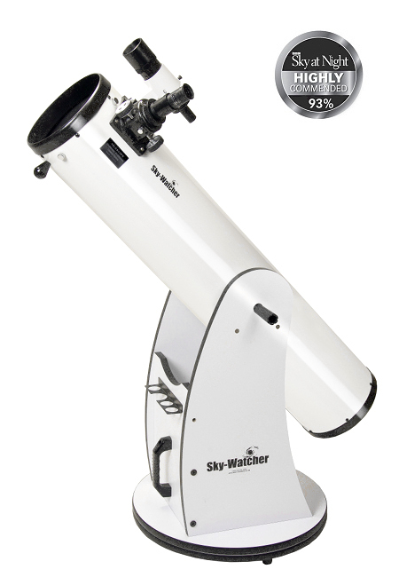
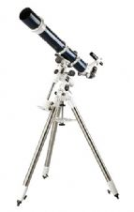
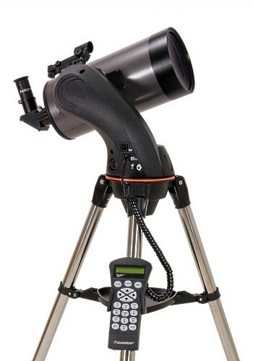
Telescopes – UPTO £500
Dobsonian
6 Inch £200
8 Inch £300
10 Inch £450
102 mm Refractor
Manual EQ £400
127 Maksutov Computerised Go-To £370

Slide 9
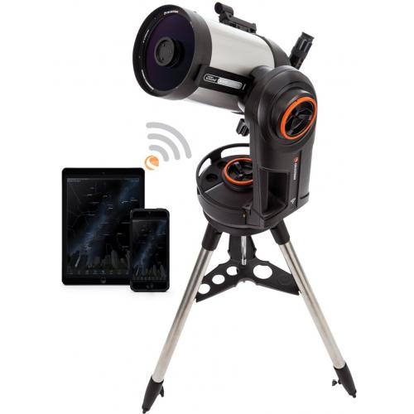
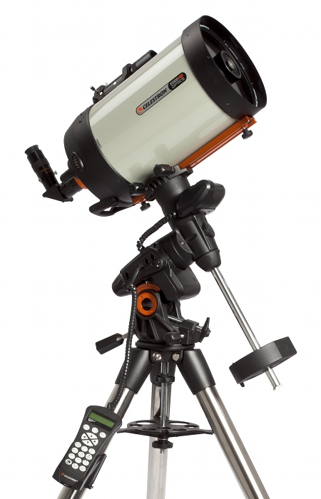
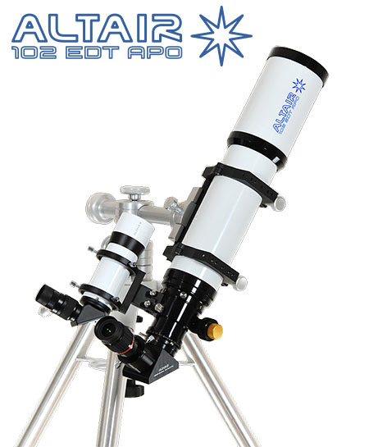
Telescopes – UPTO £1500
Celestron NexStar Evolution
6 Inch £1,000
8 Inch £1,500
Celestron Advanced
VX Edge 8 HD £1,500
Altair Wave Series
APO 102mm £1,500

Slide 10
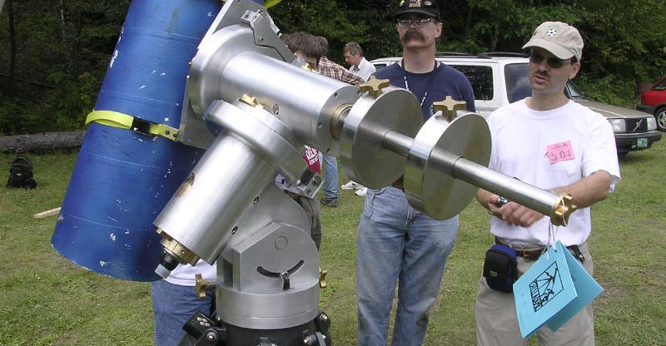
PIER OR TRIPOD?

Slide 11
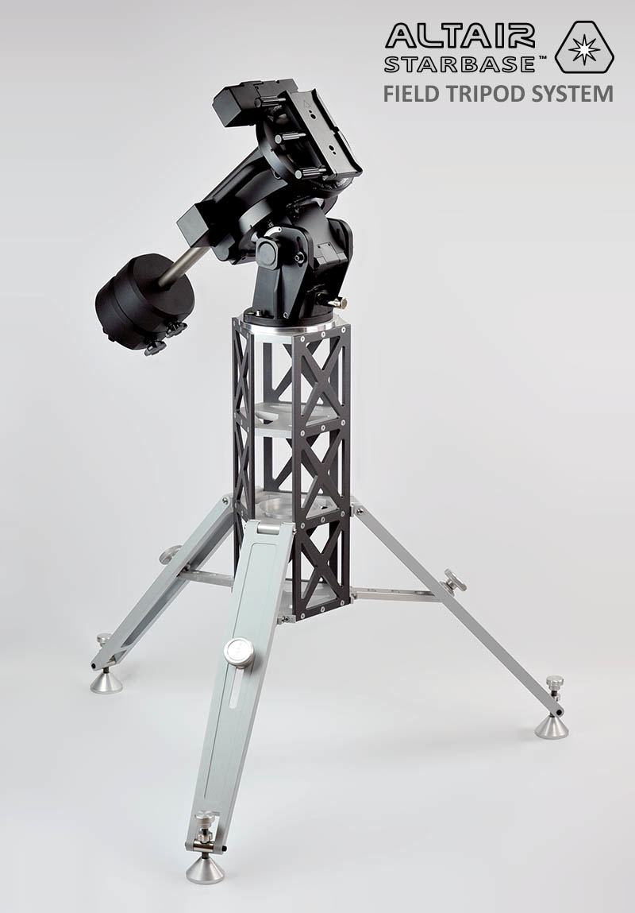
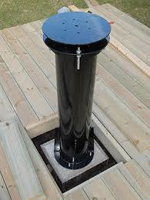
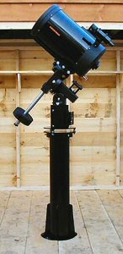
PIERS

Slide 12
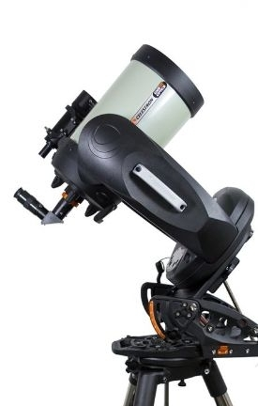
Telescopes – ADVANCED
11 Inch Fork Mounted Edge HD SCT
Equatorial Wedge
Permanent Observatory Pier
£5,200
With STD SCT
£3,300
Baader Hyperion Eyepiece Kit
£600

Slide 13
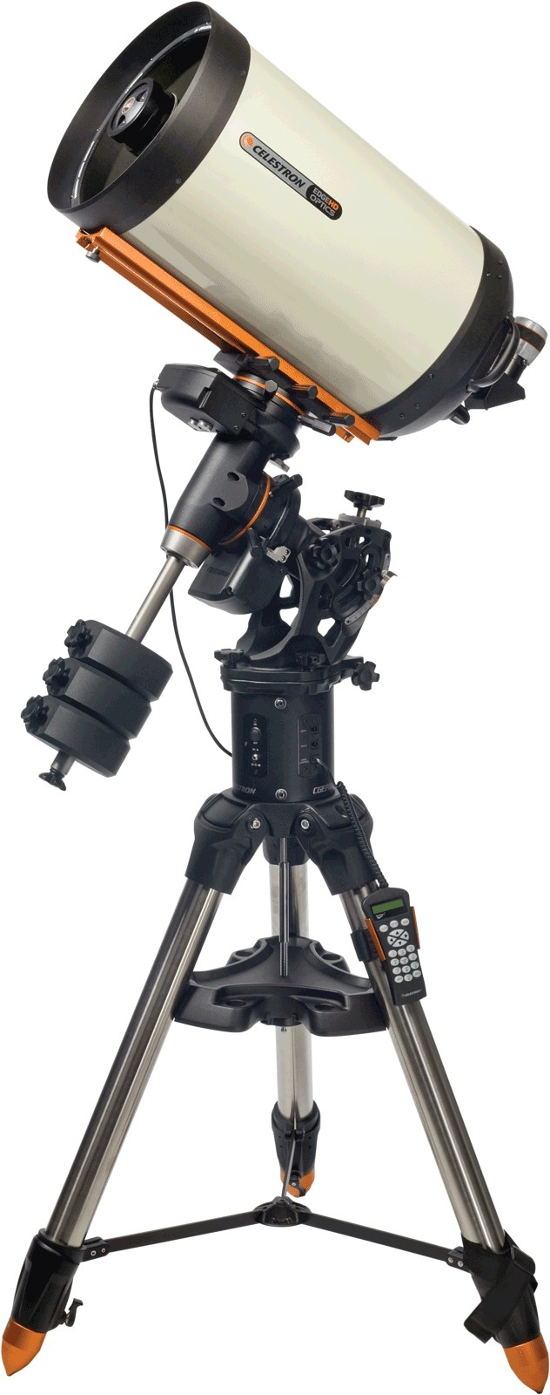
Telescopes – ADVANCED
14 Inch Edge HD SCT
CGE Pro Mount
Permanent Observatory Pier
£11,300
With STD SCT from
£7,500
Baader Hyperion Eyepiece Kit
£600

Slide 14
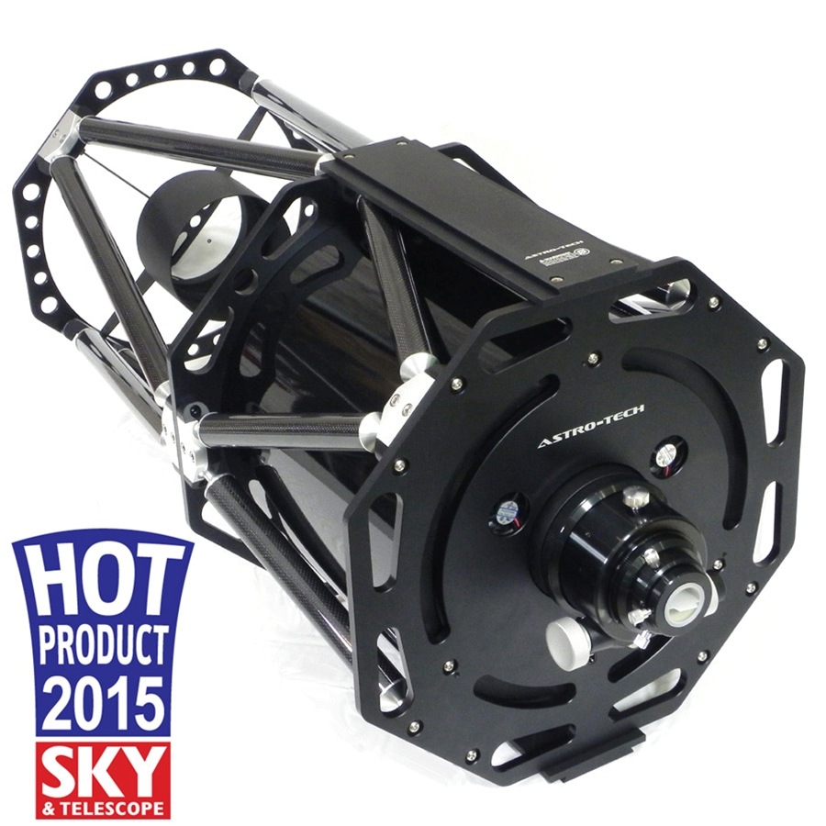
Telescopes – ADVANCED
Altair Astro RC300-TT 12" Truss Tube
Ritchey Chretien Astrograph
£3,200

Slide 15
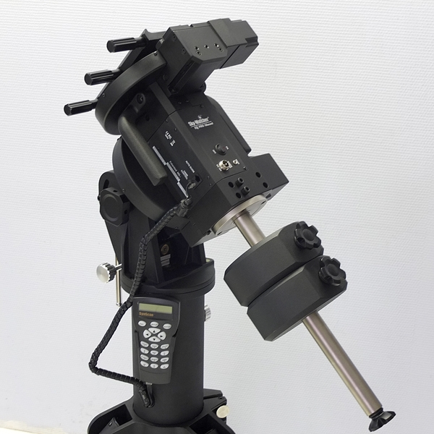
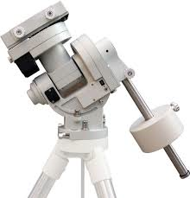
Telescopes – ADVANCED
Sky-Watcher EQ8
£2,500
iOptron CEM60
£2,300

Slide 16
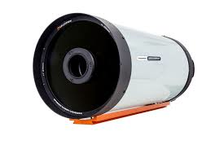
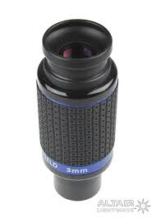

Telescopes – ADVANCED
+
+
Mounts, Optical Tube Assemblies, eyepieces and many other accessories can be mixed and matched!
be clear on what you what to achieve
balance capability and practicality
consider the environment you’ll be using it in

Slide 17
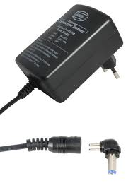
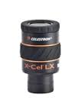
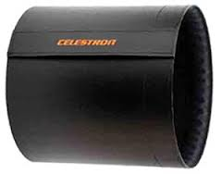
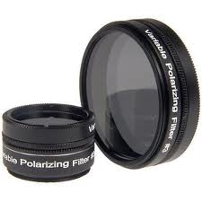
ACCESSORIES – SO WHAT ELSE DO I NEED?
Power Supply
  Mains Adaptor from £25 - £50
  Rechargable from £60 -£220
Eyepieces
  From £30 -£500+ each!
  Basic Kits from £150
  Premium Kits From £600
Filters
  Basic Moon Filter £10
  Variable Polarising Filter £30
Dew control
  From £30 for a basic shield

Slide 18
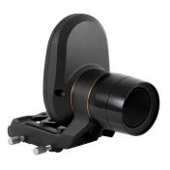

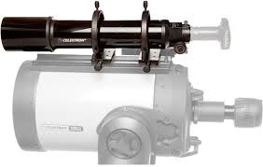
ACCESSORIES – ALIGNMENT & TRACKING AIDS
Help aligning your mount
  GPS from £99 - £160
  Starsense £280
Improving tracking accuracy (For photograpy)
  Guidescope kits from £200
  Guide Cameras From £200

Slide 19
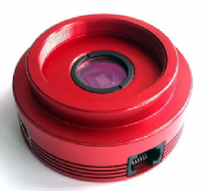
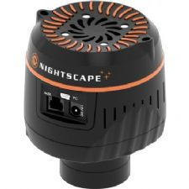
ACCESSORIES – Imaging
Planetary Cameras – Bright Objects Fast Exposures!
  Prices from £99 - £500
  Mono more sensitive than colour but more effort
  Work with basic tracking mounts including Alt-Az
Deep Sky Cameras – Faint objects Long Exposure!
  For budgets less than £1000 Use DSLR
  CCD Cameras are more sensitive
  Cooled CCD can take longer exposures without noise
  Mono versions more sensitive than colour
  Prices £1200 - £5000+
  Filters £100+ each
  Quality EQ Mounts a MUST.

Slide 20
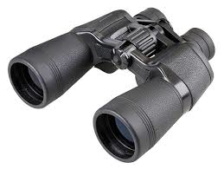
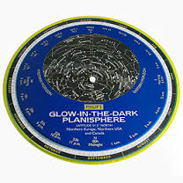
BACK TO A BEGINNERS GUIDE!
Don’t underestimate what can be achieved with humble equipment!
10x50 Binoculars
Planisphere
£65

Slide 21
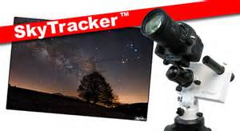
BACK TO A BEGINNERS GUIDE!
Don’t underestimate what can be achieved with humble equipment!
iOptron SkyTracker - £320
Attach to camera tripod
Use with DSLR

Slide 22
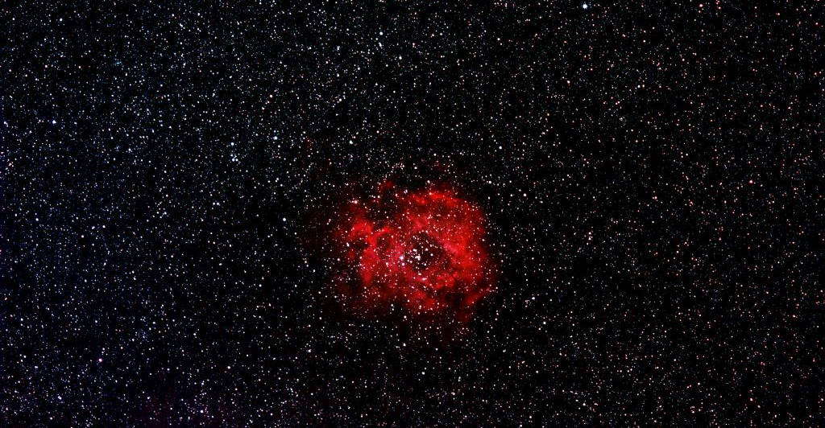
ROSETTE NEBULA SkyTracker CanoN 200mm
Image credit Mark Cullen

Slide 23
SUMMARY
Finding the right package is about balancing and matching practical aspects
as well as budgets;
Be clear about your objectives
Match requirements and equipment capability carefully
Do no over complicate
Be realistic about your local environment
Remember sometimes less can be more

Slide 24
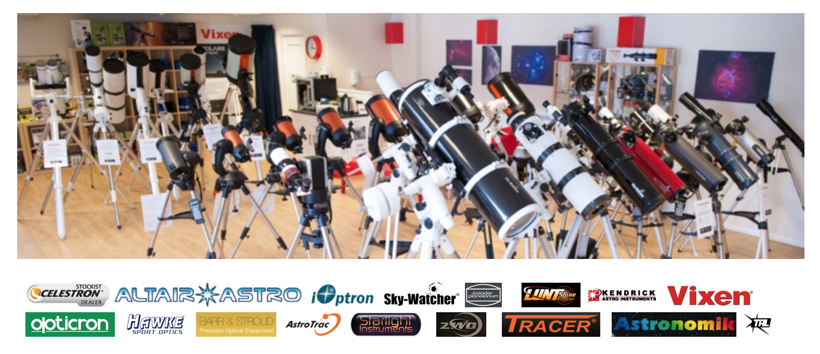
Thank you – Q&A
www.tringastro.co.uk
www.siriusastronomy.co.uk

