Slide 1


Gender Balance and Inclusion through Space
Space Education Workshop Leiden, 2016
Ramasamy Venugopal, rv@astro4dev.org Kevin Govender, kg@astro4dev.org www.astro4dev.org

Slide 2


Slide 3
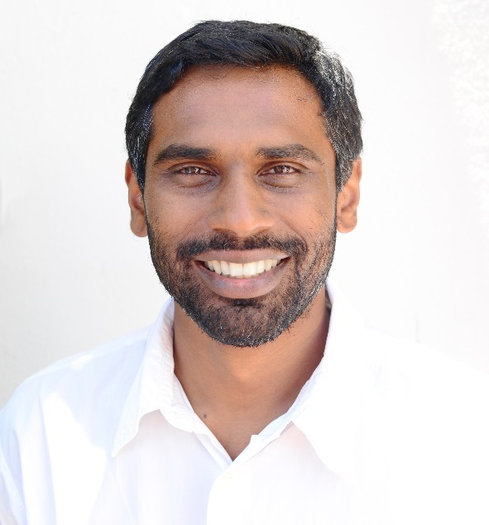
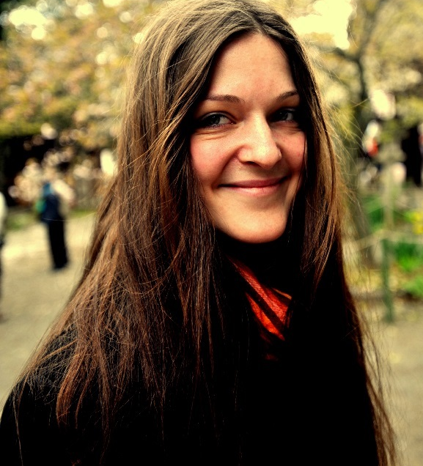
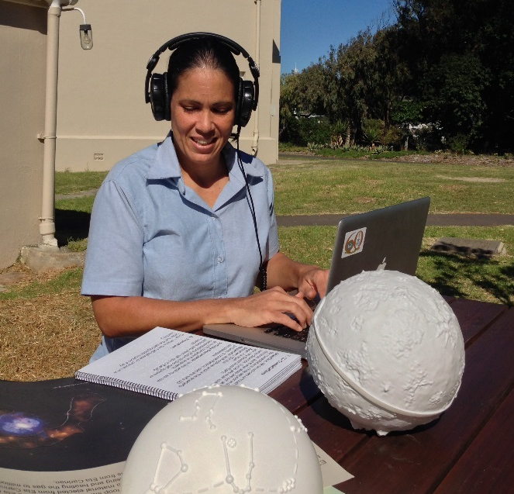
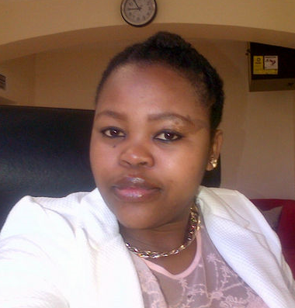
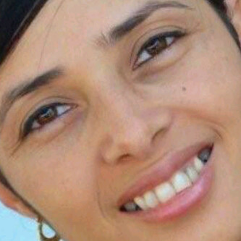
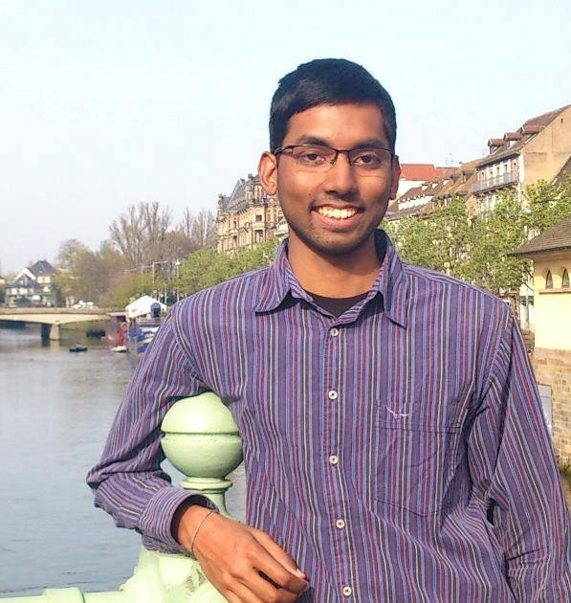
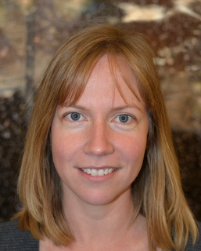
South Africa
Indian
US/UK
Mixed
Puerto Rico
Latino
Physicist
Social Scientist
Astronomer
Hindu
Christian
Buddhist
South Africa
African
South Africa
Malay
India
Indian
South Africa/UK
European
Media
Admin
Engineer
Astronomer
Christian
Muslim
Hindu
Christian
Notes:
although mostly used in the context of ethnicity, gender, age and religion

Slide 4
“Diversity actually encompasses the infinite range of individuals' unique attributes and experiences”, – US Dept of Labor

Slide 5
Space & Astronomy are Special
Not just inspire students to take an interest in STEM…but to help
Understand our Place in the Universe Appreciate our Connection to each other Promote Tolerance, Inculcate Diversity

Slide 6


Slide 7
Activity
for primary school children in Cape Town, SA
Our Place on Earth: Countries & continents
Our Place in the Solar System
Our Connection
Survey and Measurement

Slide 8
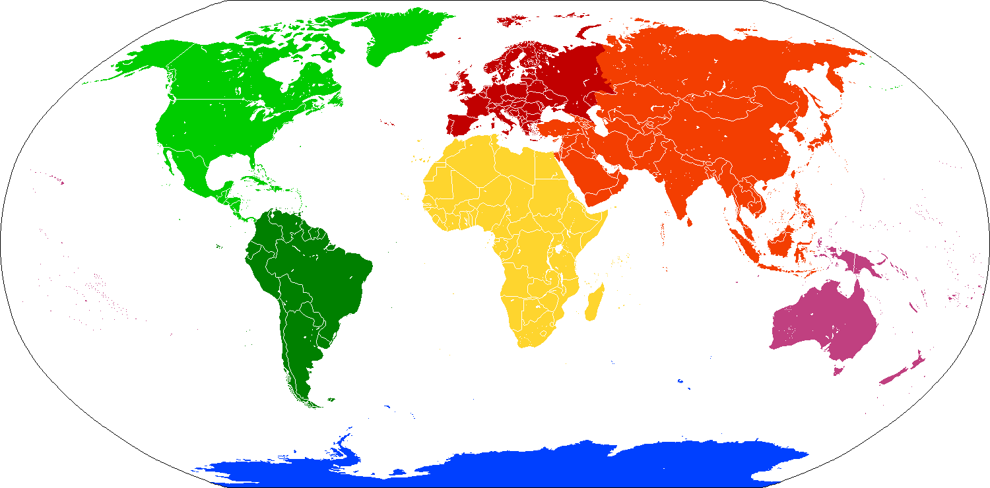
Our Place on Earth

Slide 9
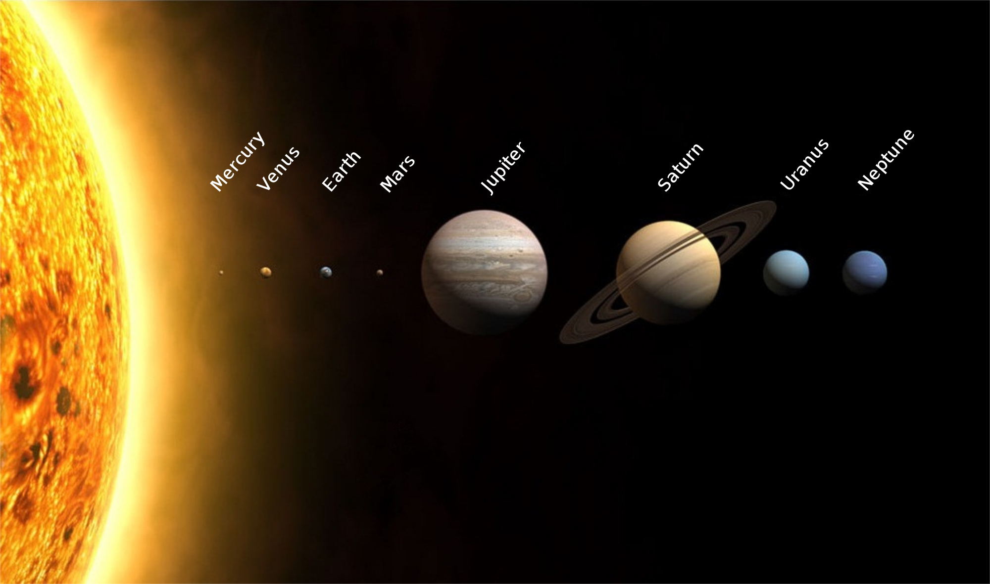
Our Place in Solar System

Slide 10
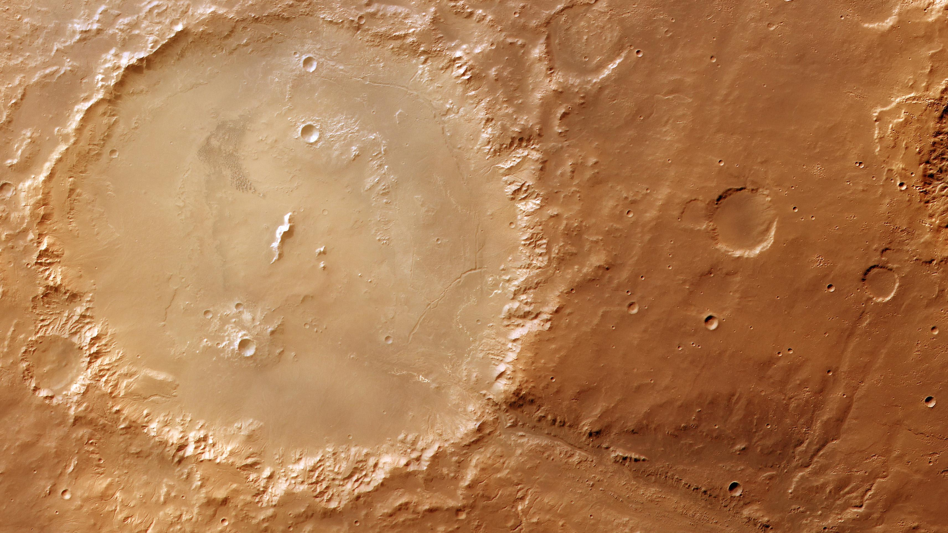
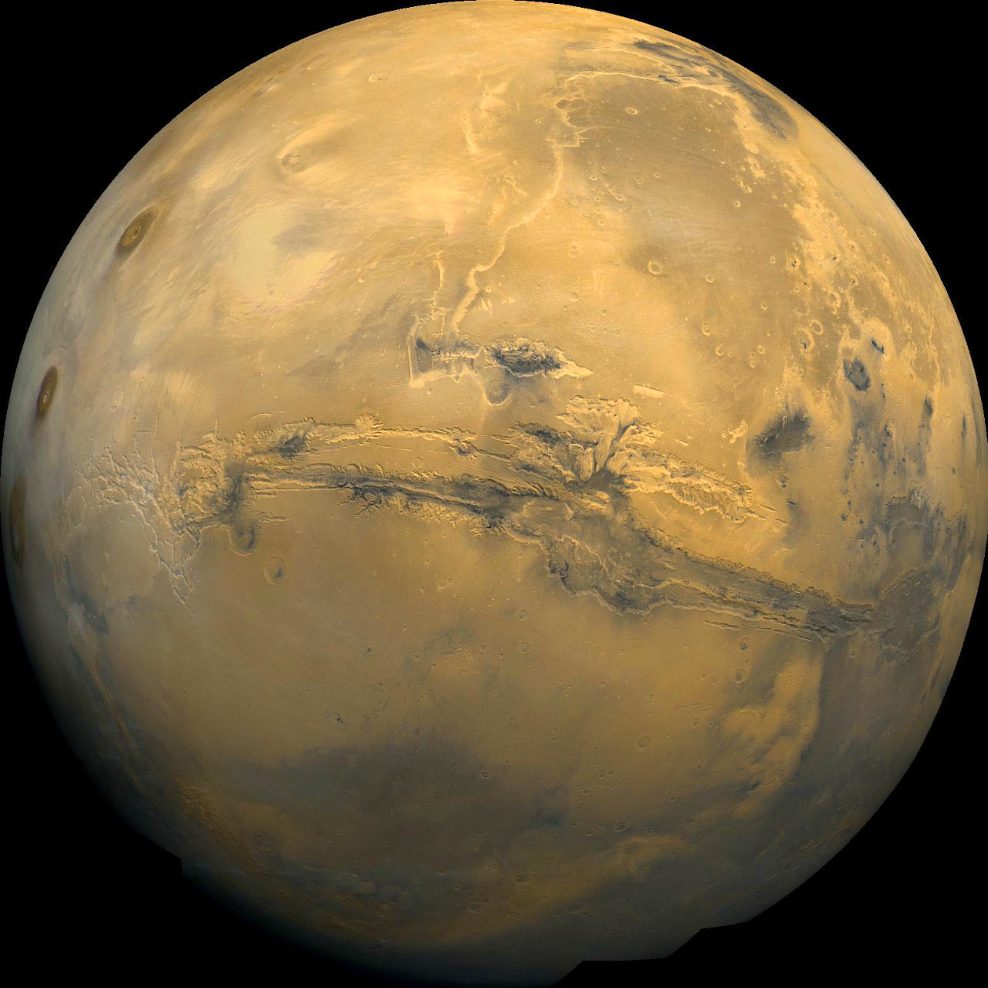
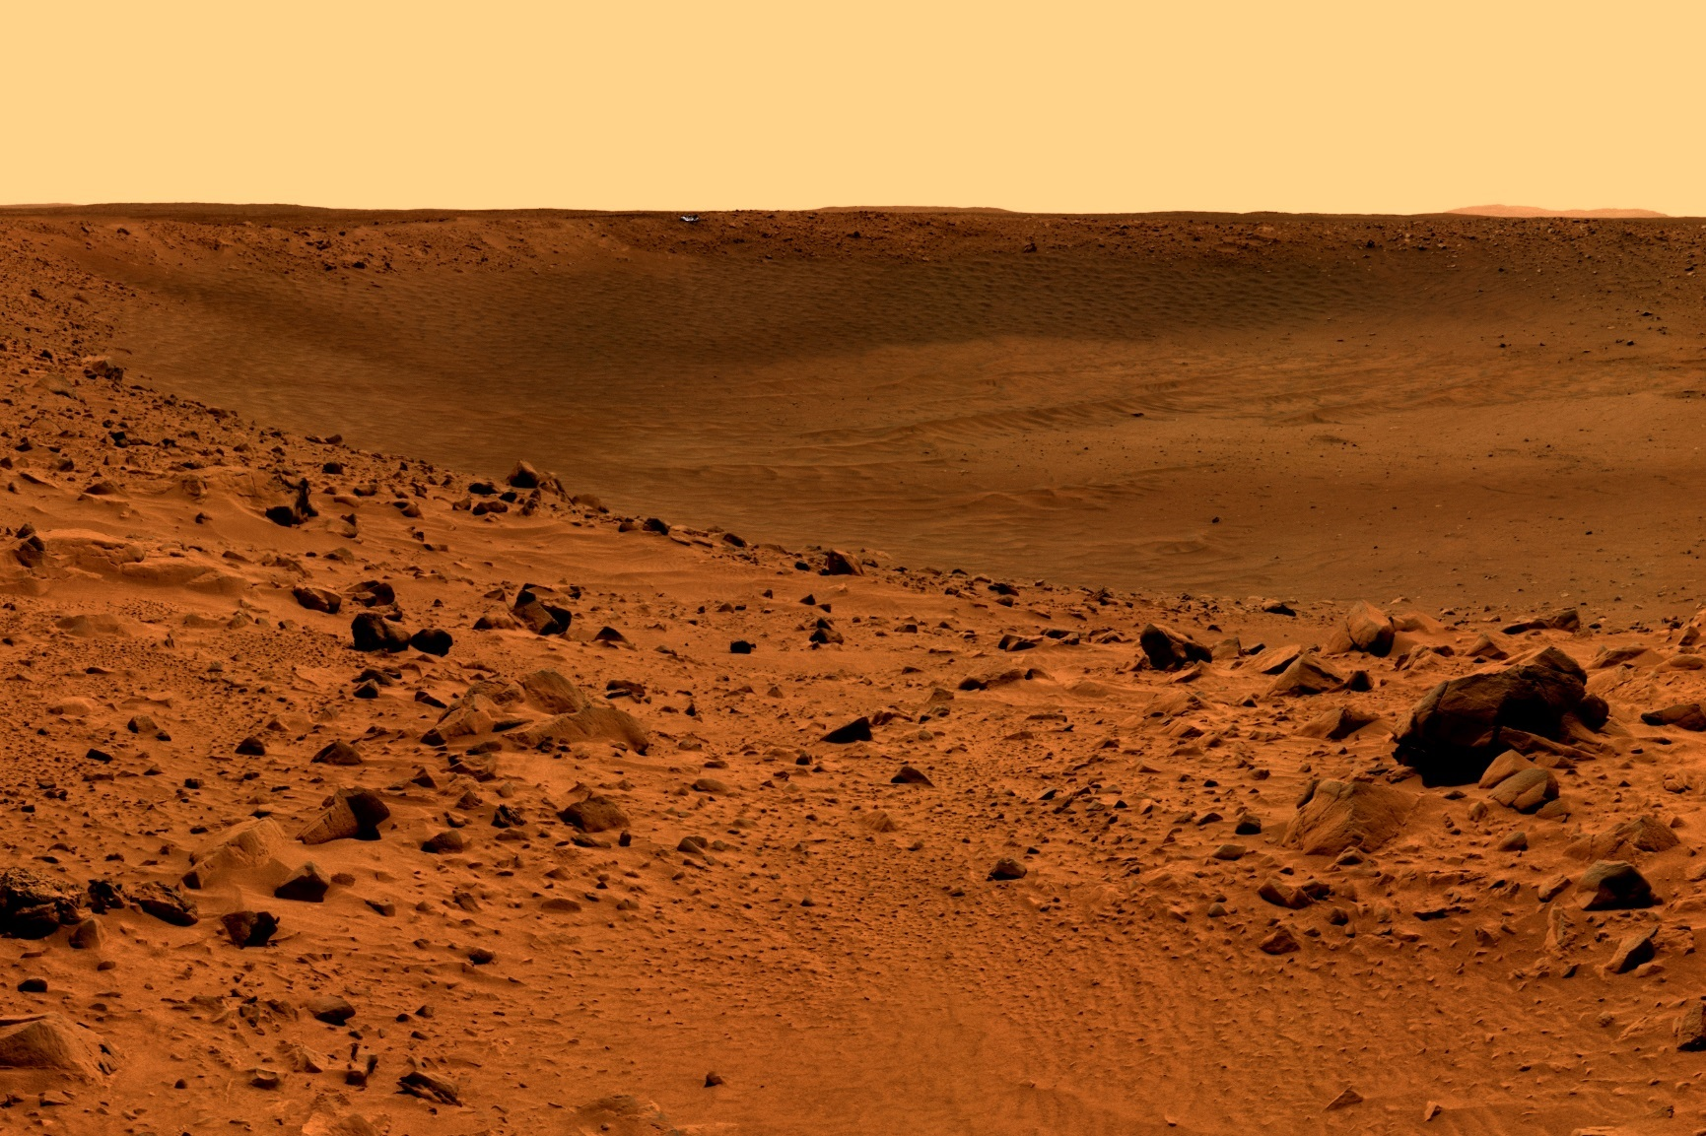
Contrast with Mars

Slide 11
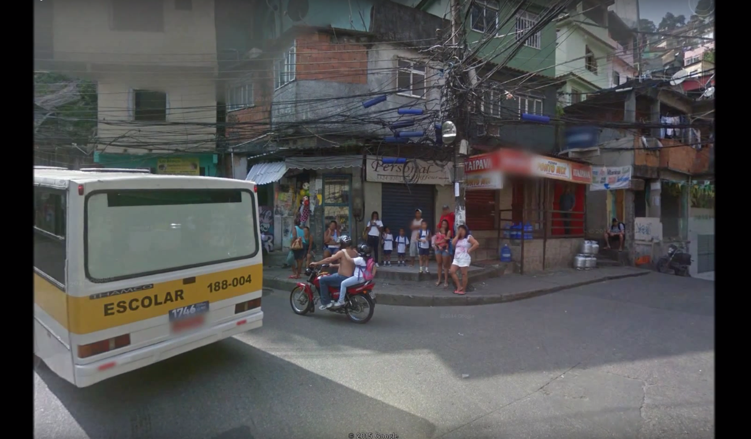
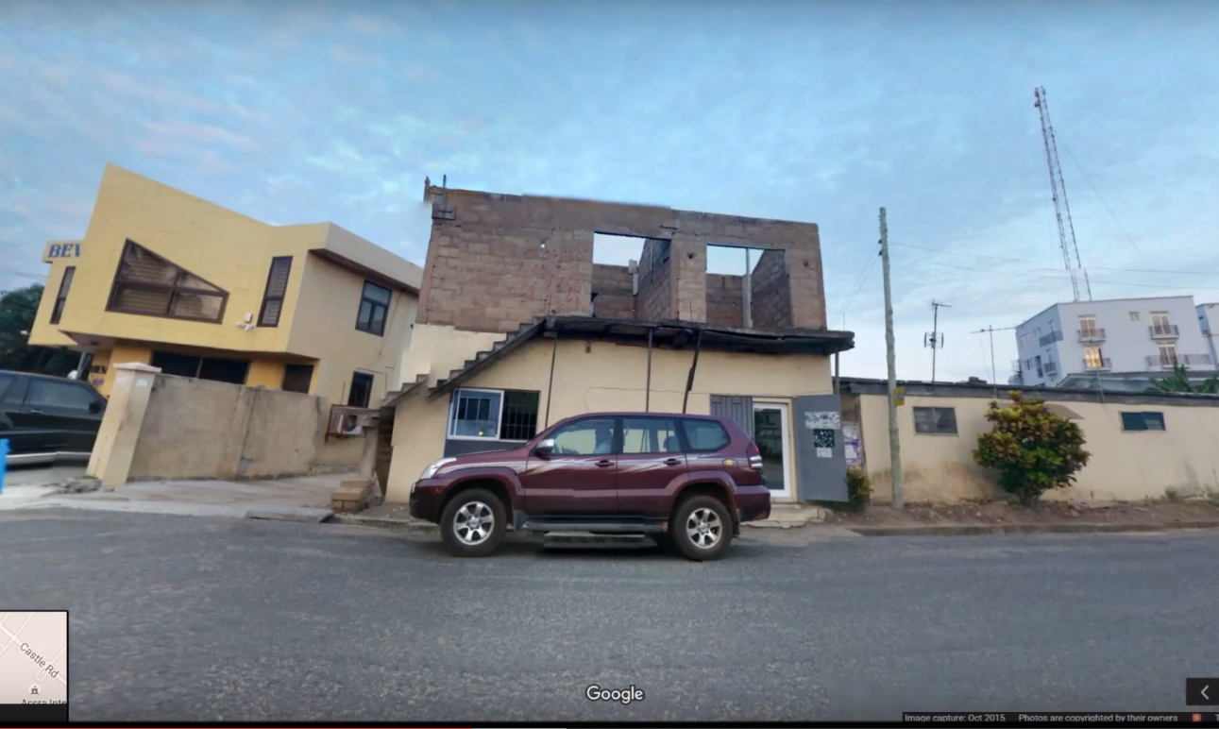
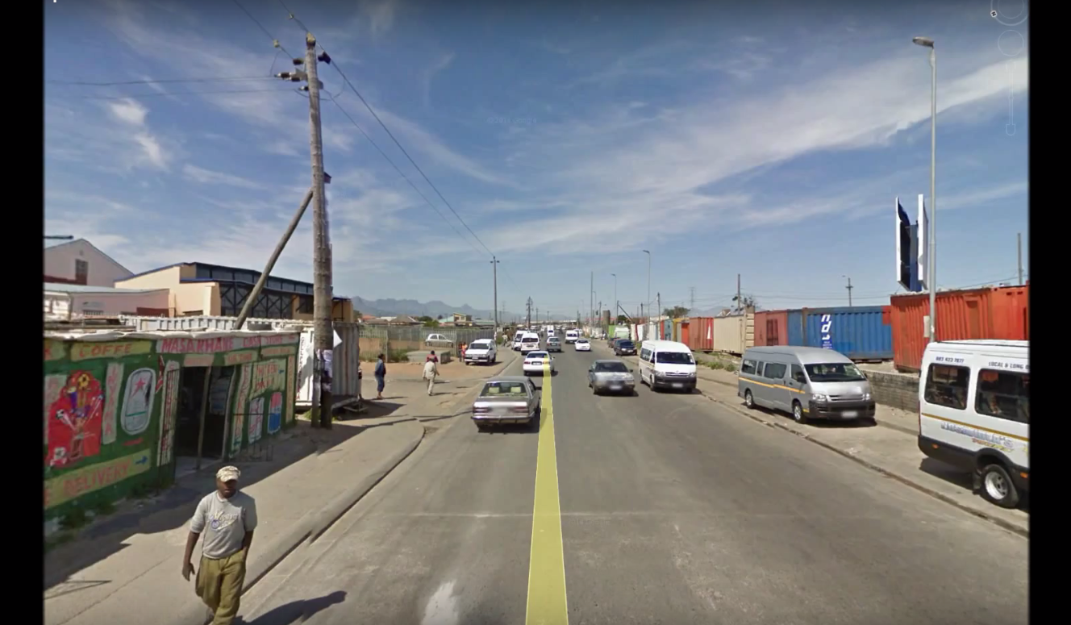
Our Connection
Notes:
2 countries – on Different continents, ethnicities, similar developmental status.
Show culture, way of life may be different but we all share the common bond of humanity.
For Europe – perhaps choose countries that children usually don’t have strong associations with. For example, don’t choose USA but …

Slide 13
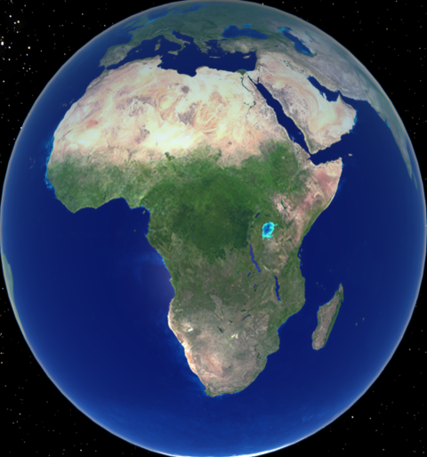



SOUTH AFRICA
KENYA
Notes:
Something like:
You have been given 3 tokens. Each token represents 1 rand (5 rand?). You get to decide who you want to give this money to as a gift! You can give it to both children or you can give all the money to one child. However much is given, we will give that amount in real money to these children to support their education.
Please put the tokens in now!

Slide 14

SOUTH AFRICA
Q1: How similar do you think this child is to you?
Ingaba ufana kanjani lomtana kuwe?
Little different
Wohluke kancinane
Neither different nor similar Wohluke njee, Ubufana njee
More similar than different Ubufana kancinane
Very different
Wohluke kakhulu
Very similar Ubufana kakhulu
Notes:
Very different/Wohluke kakhulu ;
Little different/Wohluke kancinane ;
Neither different nor similar / Wohluke njee, Ubufana njee;
More similar than different / Ubufana kancinane
Very similar / Ubufana kakhulu)

Slide 15
IAU Strategic Plan 2010-2020:
ASTRONOMY
ELECTRONICS
Most sensitive detectors
Fastest clocks
PHYSICS
Laboratory of extremes
Making heavy elements
CHEMISTRY
Producing organic molecules
BIOLOGY
Building blocks of life
ANTHRO-POLOGY
Ancient civilizations
Our roots
INSPIRAT ION
Career in science and technology
HISTORY
Evolution of Universe
Our roots
OPTICS
High-precision adaptive optics
COMPUTERS
Fastest hardware
Complex software
SPACE
Satellite Miniaturization
Precision
PERSPECTIVE IMMENSITY OF UNIVERSE
Tolerance and global citizenship
MATHEM-ATICS
Abstract thought
TECHNOLOGY
AND SKILLS
CULTURE
AND SOCIETY
SCIENCE AND
RESEARCH
Notes:
The IAU Strategic Plan was ratified at the IAU General Assembly in Brazil in 2009.
This plan aims to use astronomy to stimulate development at all levels including primary, secondary and tertiary education, science research and the public understanding of science
The strength of astronomy is that it straddles key areas which often serve as a measure of a developed society i.e. Technology, Science and Culture

Slide 16

SDGs

Slide 17
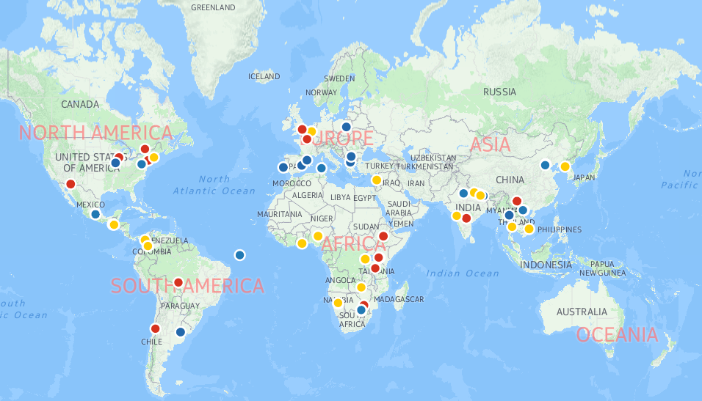


Funded Projects (86)
www.astro4dev.org/cfp
Notes:
Just to give an idea of the geographical spread
One liners on some 2013 projects:
TF1 (Universities and Research):
Rwanda: school for data analysis and using Virtual Observatory
China/DPRK: re-integration of DPRK astronomers into international community
Nepal: school for young astronomers
Nigeria/Zambia/Brussels: Virtual telescope control room in universities using remote telescopes
Ghana: school for potential astronomy students and teachers
Lebanon: school on use of small telescopes for astronomical research
Guatemala: regional school for young astronomers
TF2: Children and schools:
Spain/global: astronomy kit with tactile resources for the visually impaired
Kenya: teacher training network in slums of Nairobi
Nepal: teacher training on astronomy tools and resources
Kenya/Ghana: teacher training network on simple astronomy kits
Greece: applying scientific methodology/techniques used in ancient Greece to modern classrooms
TF3: Public:
US: using astronomy at Ronald Mcdonald homes to inspire/uplift traumatically ill/injured children and their families
Colombia: astronomy and art project for the public
China: finding astronomy in ancient Chinese poetry and getting modern astrophotographers to depict them
Vietnam: public outreach events in rural Vietnam with development of a clubs network
South Africa: public outreach in rural parts of Limpopo
US/several African countries: dark skies awareness – kit was distributed to several countries and training conducted by Google hangouts

Slide 18
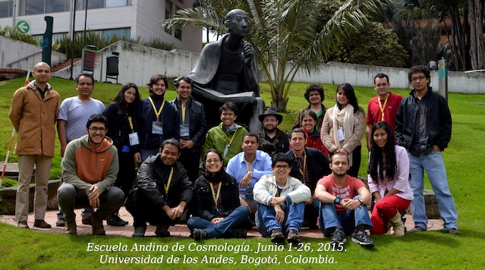
Task Force 1

Slide 19
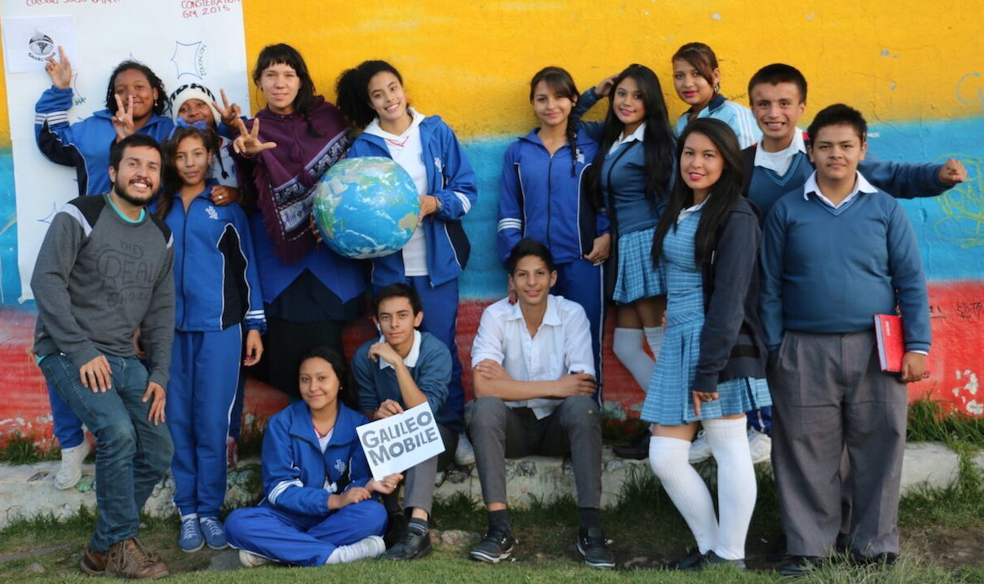
Task Force 2

Slide 20
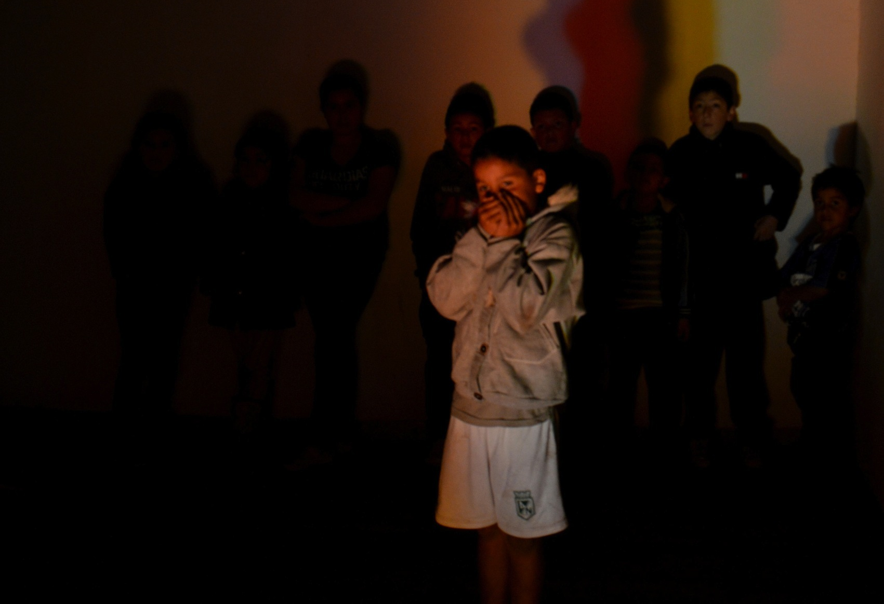
Task Force 3

Slide 21
Space Education Workshop Leiden, 2016
Ramasamy Venugopal, rv@astro4dev.org Kevin Govender, kg@astro4dev.org www.astro4dev.org

Slide 22


Slide 23
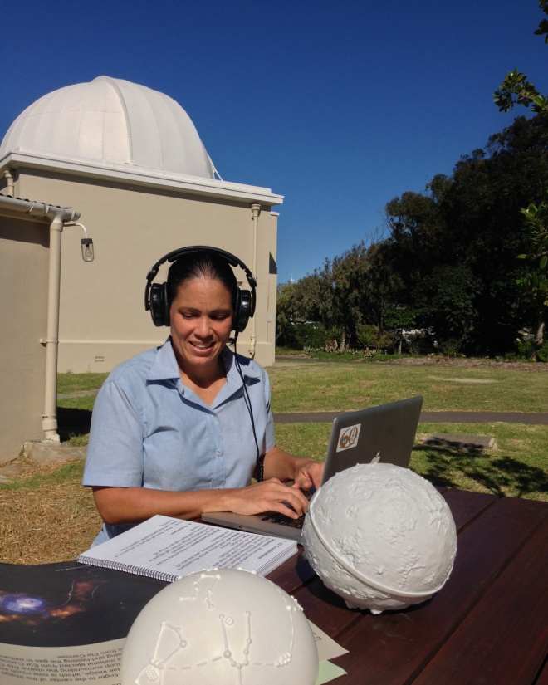
Ad-hoc Projects
AstroVarsity
provide course and tutorial resources for Maths & Physics lecturers at undergraduate level
AstroSense
Accessibility and Inclusion
Ultrascope and 3D printing
NASA Asteroid Grand Challenge
Randomized Control Trial
Previous – AstroTruck, AstroPack, AstroComputing

Slide 24
OAD Structure
OAD Steering
Committee
OAD
Regional
Coordination
Universities & Research
Children & Schools
General
Public
“Astronomy for a better world!”
Notes:
OAD falls under the IAU and all credit goes to the IAU

Slide 25
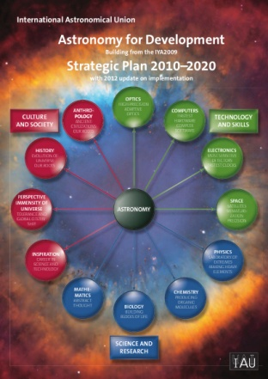
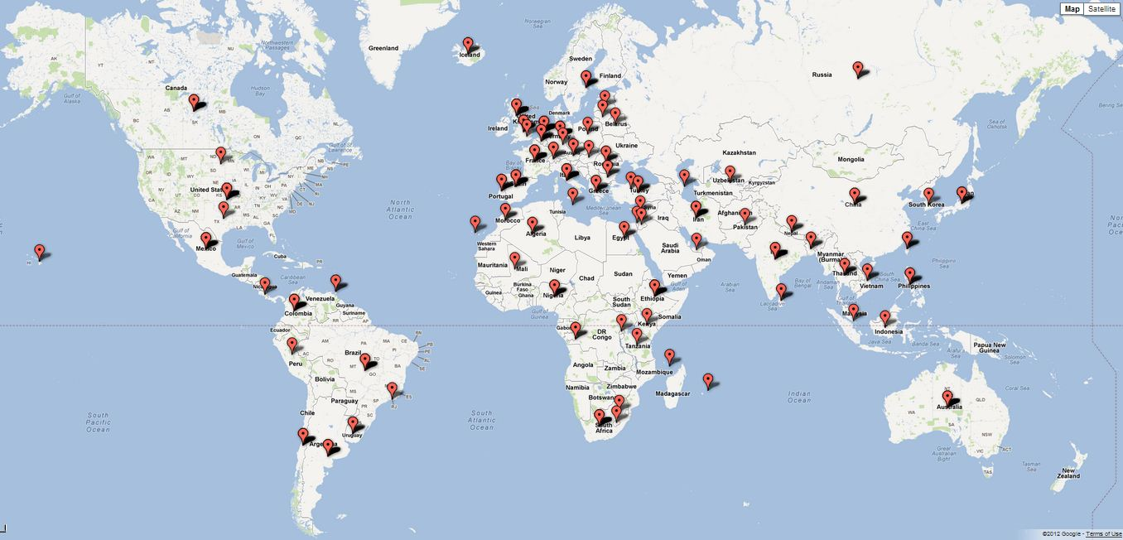
OAD Volunteers
IAU members, amateurs, professionals, teachers, students, public
Over 550 worldwide (on this map they are grouped by location)
www.astro4dev.org/volunteers
Notes:
Volunteers register their skills and interests with the OAD.
We use this database whenever opportunities arise
Example: Ethiopia needed astronomy and instrumentation skills for their new telescopes – over 20 feasible offers of assistance
Have a matching process with opportunities – need to automate this
With more funds can do more with volunteers
Use them to support wish list projects

Slide 26
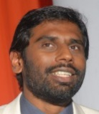


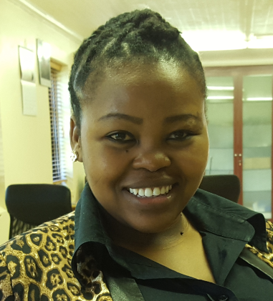

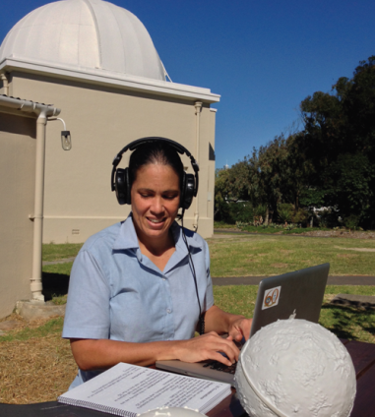
Staffing
Director
Programme Coordinator
Astronomer
Office Manager
Fundraiser
Interns
Fellows
Volunteers
Postdocs

Slide 27
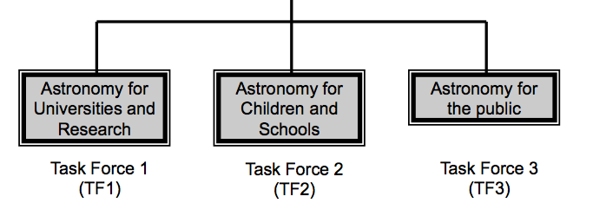
OAD Task Force membership
Nicole van der Bliek (Chile/Netherlands)
Jean-Pierre de Greve (Belgium)
Michele Gerbaldi (France) – Co-Chair
Edward Guinan (Chair – USA) – Co-Chair
Roger Hajjar (Lebanon)
Edward Jurua (Uganda)
Stella Kafka (US)
Hakim Malasan (Indonesia)
Shengbang Qian (China)
Ravi Sheth (ICTP/Italy)
Edward Gomez (Co-chair – UK) – Co-Chair
Jen Gupta (UK)
Robert Hollow (Australia)
Ofodum Chukwujekwu Nworah (Nigeria)
Linda Strubbe (Canada/USA)
Akihiko Tomita (Japan)
Amelia Ortiz-Gil (Spain) – Co-Chair
Tsolmon Renchin (Mongolia)
Lina Canas (OAO/Japan)
Megan Argo (Australia/Commission C2 Nomination)
Kimberly Arcand (US)
Sze-leung Cheung (OAO/Japan)
Thilina Heenatigala (Sri Lanka)
Carolina Odman (South Africa) – Co-Chair
German Puerta (Colombia)
Kumiko S. Usuda (Japan/USA) – Co-Chair
Brooke Simmons (UK)
Notes:
TFs established through open call for nominations as well as mix of experienced, new blood and ex-officio (e.g. Commissions 46, 55, OAO)
Will soon be looking for new people to serve on the TFs

Slide 28









OAD Partners
Notes:
Partners support wish list projects – we refer recommended projects to these opportunities.
RAS: visiting experts – soon to be both ways
NWO: visiting experts outwards from Netherlands
ICTP: workshops, associates, travel grants
IUCAA: hosting developing astronomers
UCLan: distance learning astronomy module
HdA: one day per week staff time to help with Latin America
Fiat Physica: Fundraising for OAD “wish list” projects
Associated Universities Inc/Leiden University: Exchange programme and resource development/dissemination

Slide 29
OAD Annual Call for Proposals
2013 Projects (191)
2014 Projects (230)
2015 Projects (131)
2016 Projects (124)
Astronomy for Universities and Research
42 applications
54 applications
31 applications
28 applications
€ 752,959 requested
€ 919,308 requested
€ 514,103 requested
€ 232,257 requested
Astronomy for Children and Schools
96 applications
113 applications
67 applications
66 applications
€ 772,079 requested
€ 864,731 requested
€ 431,695 requested
€ 654,802 requested
53 applications
63 applications
33 applications
30 applications
Astronomy for the public
€ 310,782 requested
€ 453,805 requested
€ 178,254 requested
€ 301,431 requested
Total requested (recommended)
€ 1,835,820
(€ 869,426)
€ 2,237,844
(€ 1,534,513)
€ 1,124,052
(€ 535,373)
€ 1,188,490
(€ 813,527)
Notes:
TOTAL 86/676 proposals funded , funded € 409,157

Slide 30
2013-16 : Demand vs Supply
€

Slide 31
2013-16 : Projects by Region
Notes:
2016-4, 2015-4, 2014-3, 2013-2 projects

Slide 32
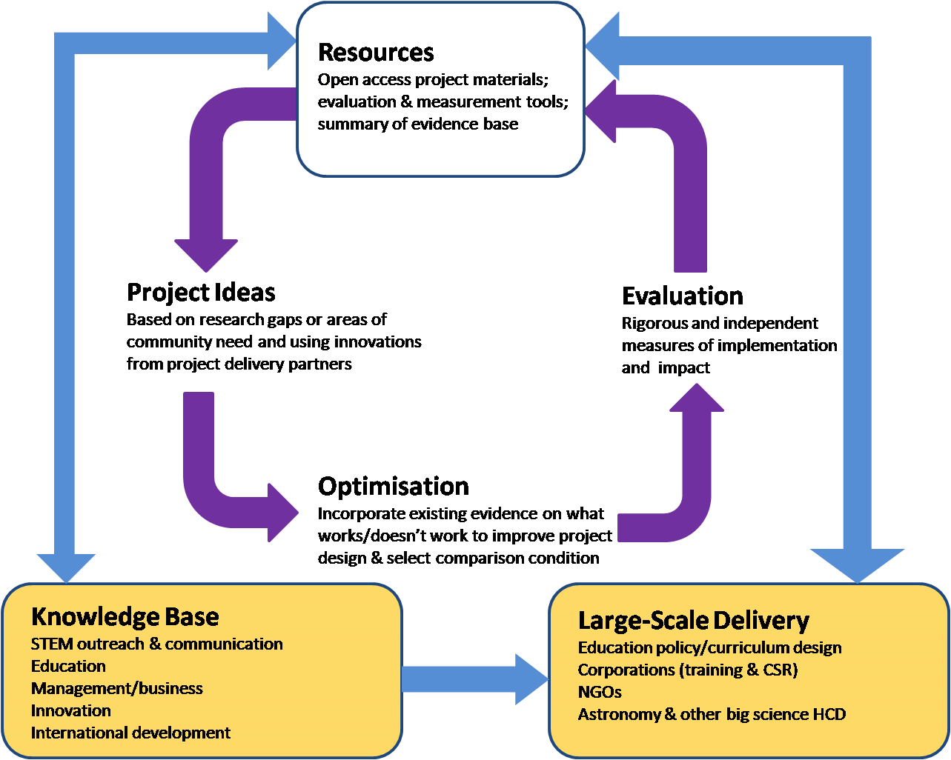
OAD Impact Cycle: Positive Feedback Loop
Notes:
Stress input from outside of Astronomy community into resources and importance of collaborating with other disciplines and communities
Steps to implementation:
Partnerships with development, for data on problems and needs
Need user –friendly interface: Integration and presentation of existing evidence, to inform design: Make it “user friendly”, summary of research – esp. appraising strength
Data- and theory-driven designs and definitions of outcome
Measuring Outcomes: Assessments to capture skill- and concept-knowledge (validated tests)
Reinforce difference between OAO and OAD: OAO is about access/exposure and the experience itself; if you want to affect development, that is OAD.
Measuring outcomes: sometimes logistical challenge (e.g. agreement with school); sometimes outcomes require more thought – e.g. blue dot test
Costs: Community-driven evaluation of test projects with support from partners ----- Address costs and challenges of evaluation: Unique feature is that astronomers are scientists.
Prediction/cross-contexts: need for system of cumulative evidence on both mechanisms and project packages, multiple trials across contexts. Complexity science focused on these issues – come talk to me.

Slide 33
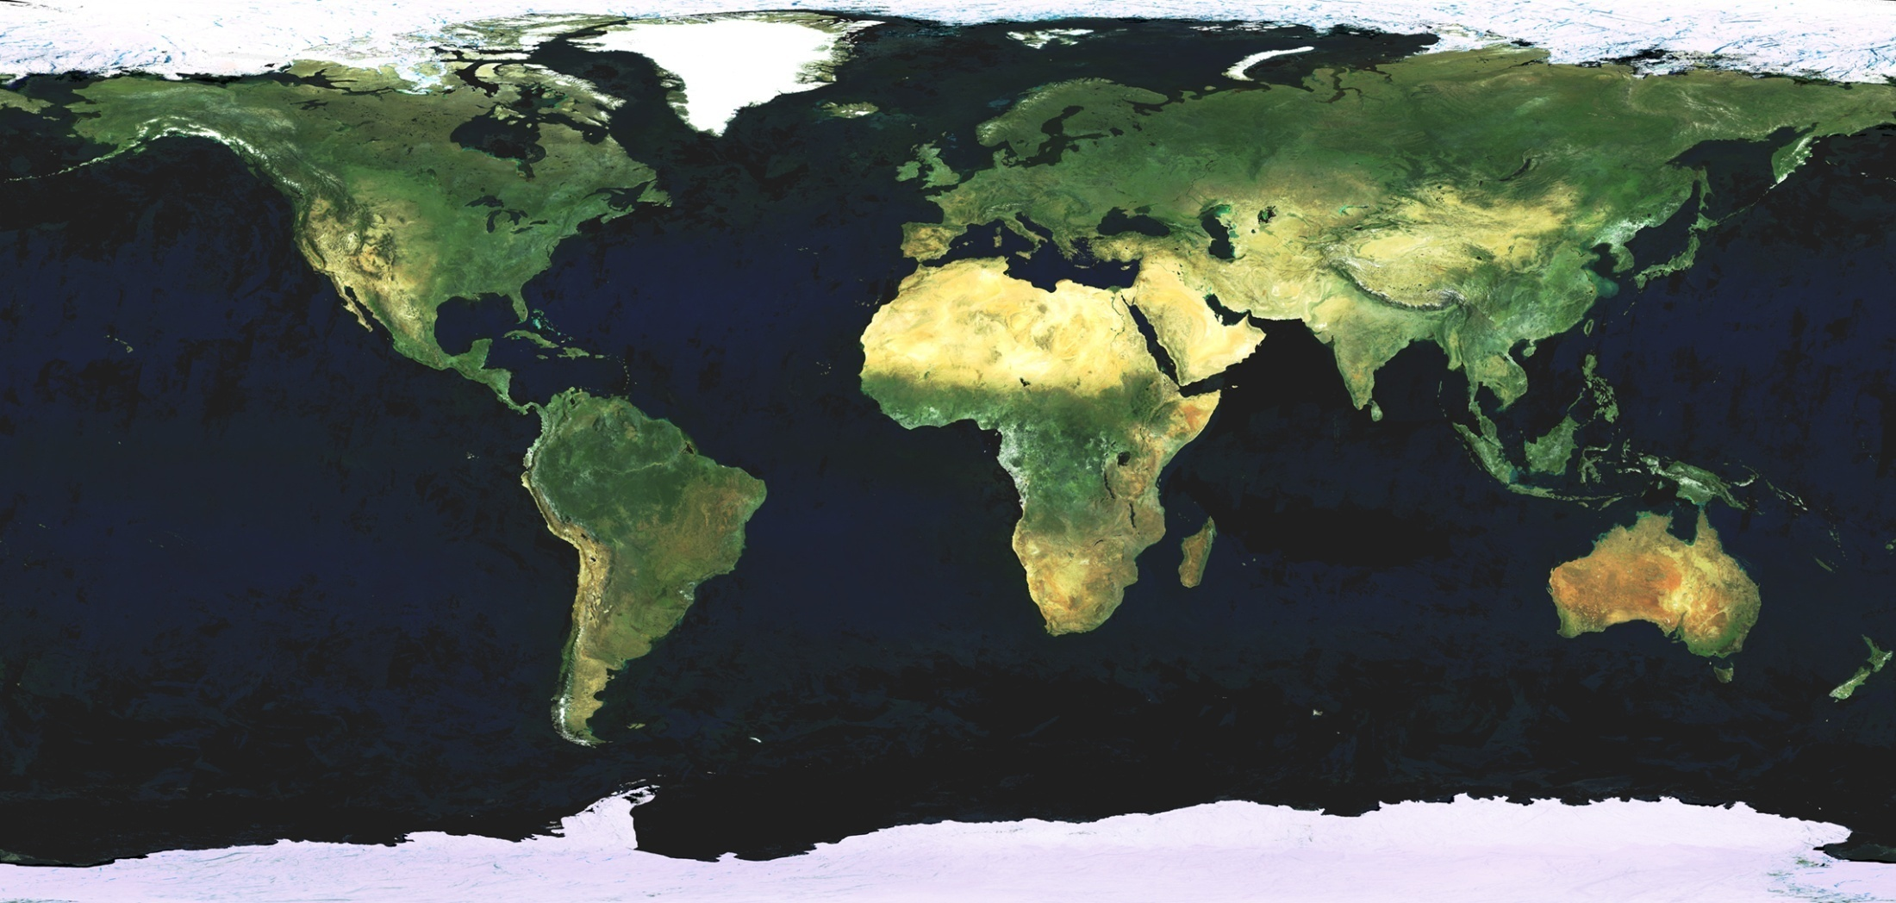
OAD Regional Offices
South West Asia
Armenia
Lusophone
Portugal
East Asia/Chinese
China
Arab World/Arabic
Jordan
South East Asia
Thailand
Andean Countries
Colombia
East Africa
Ethiopia
West Africa
Nigeria
Southern Africa
Zambia
OAD
Notes:
Minimum requirement for a regional office is a full time person with associated costs
Coordinators of regional nodes meet each quarter by telecon – face to face meeting in January 2015
Pragmatic approach to the definition of a region
Gaps in Europe and North America – would be good to have regional nodes there too

