Slide 1
Analysing Motion

Slide 2
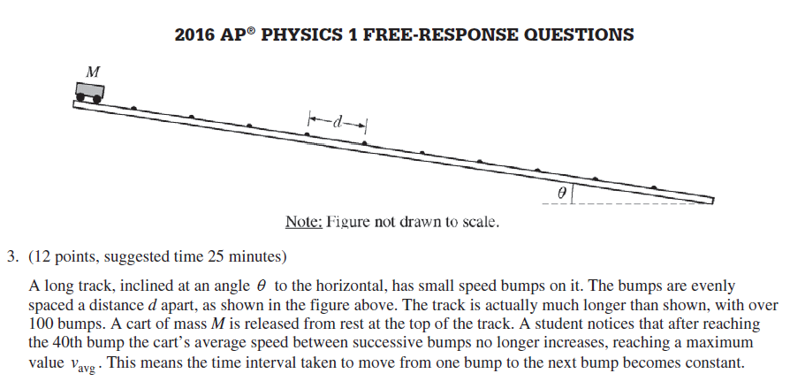

Slide 3
Objective: Students will be able to demonstrate their understanding of the difference between constant velocity and average velocity by calculating these two values for various scenarios.

Slide 4
Is there a difference between speed and velocity?
Write in your notes what you think are the definitions of constant velocity and average velocity without using your phone.

Slide 5
In groups of three: Combine your definitions and write on your whiteboard the best possible definitions of these terms.
As a class how do we define these two terms?

Slide 6
Is the motion of the cart constant velocity?
https://www.youtube.com/watch?v=v0gg1F0sz0E

Slide 7
Design a method for collecting data that will verify that this is constant motion. Include all measuring tools that you will use.
Include in your method the best possible method for measuring the average velocity.

Slide 8
In your groups of three agree on a method.
Decide how you will present your data, graph, data table, etc.
Hypothesis: Is the velocity constant
Justification: Why do you think this?
Predict what your data will look like in the graph, table, etc.
Predict what your data will look like if your hypothesis is incorrect.

Slide 9
As a class list important considerations that should be considered in conducting the investigation.

Slide 10
Collect data

Slide 11
Present your results on a white board
Decide how conclusively each group has proven their hypothesis.
List as a class how certain groups were able to prove their hypothesis more conclusively.

Slide 12
Demonstrate the video analysis method of motion analysis.
How conclusively does this method meet the objectives?

